Slide 1

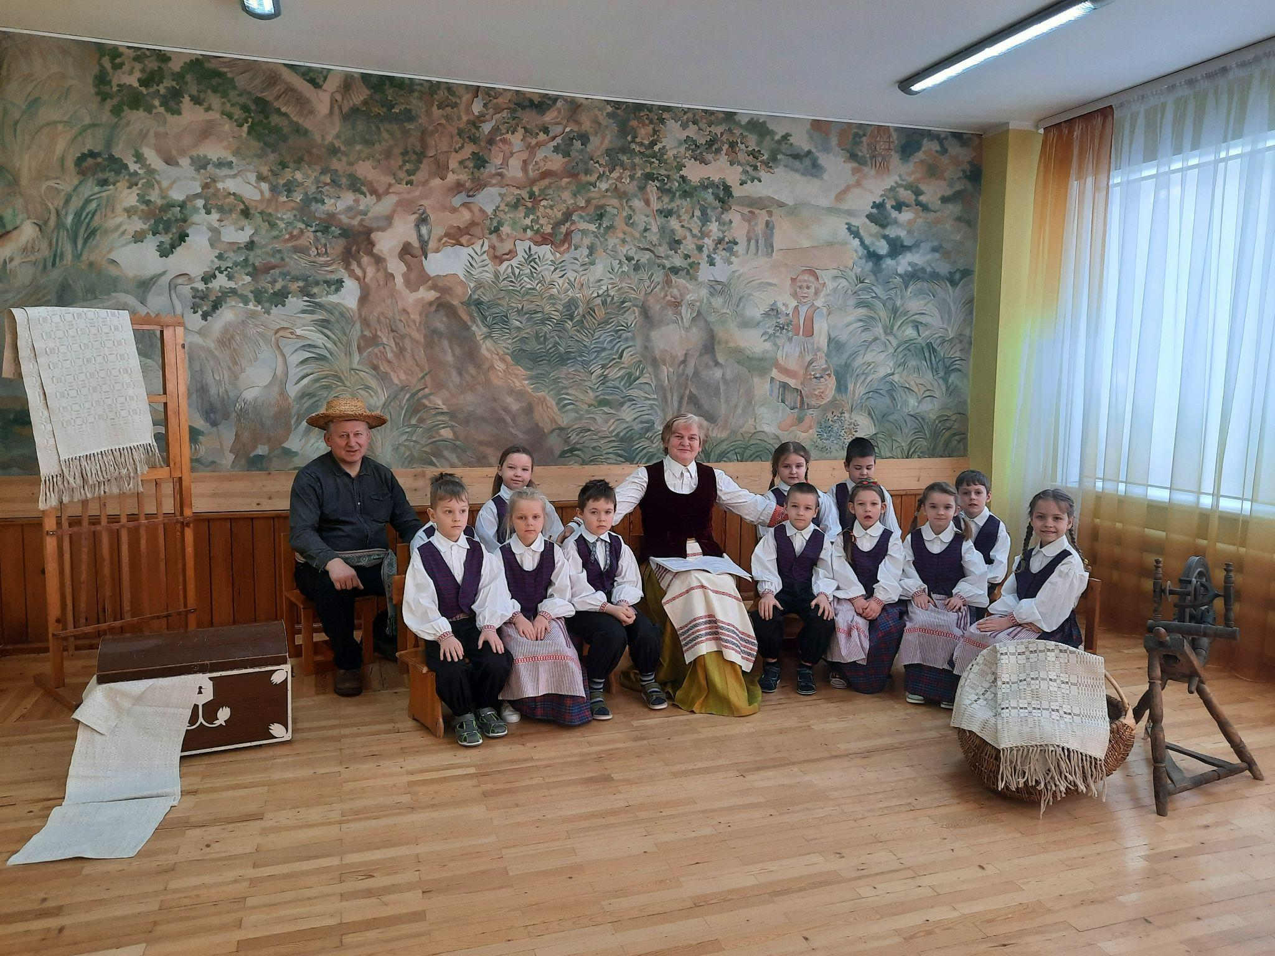
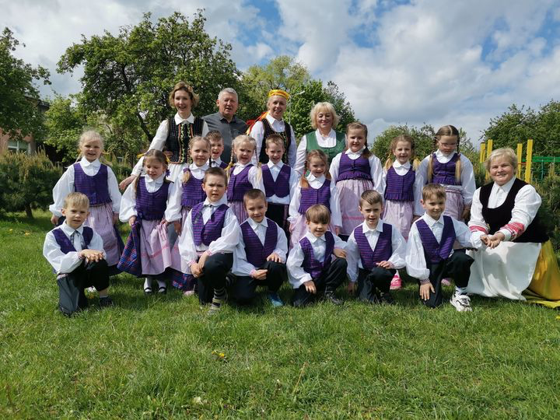
Šilutė kindergarten ‘‘Raudonkepuraitė“

Slide 2
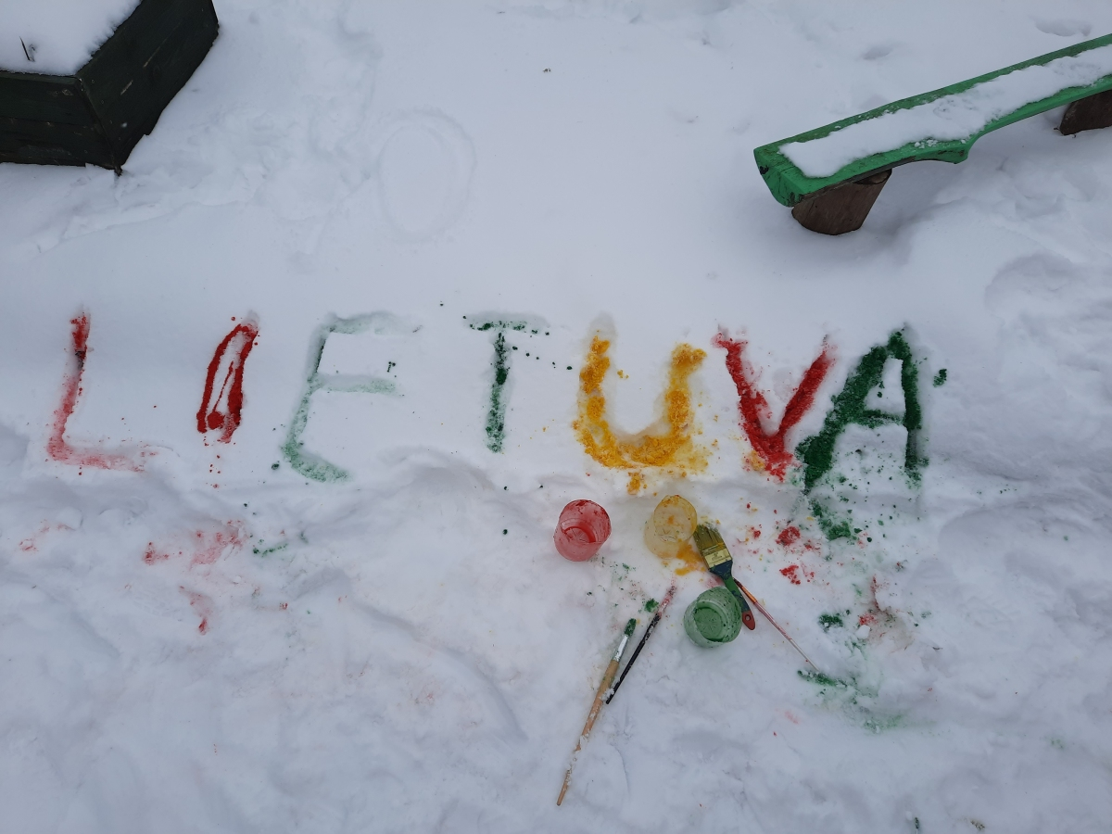


Lithuania

Slide 3
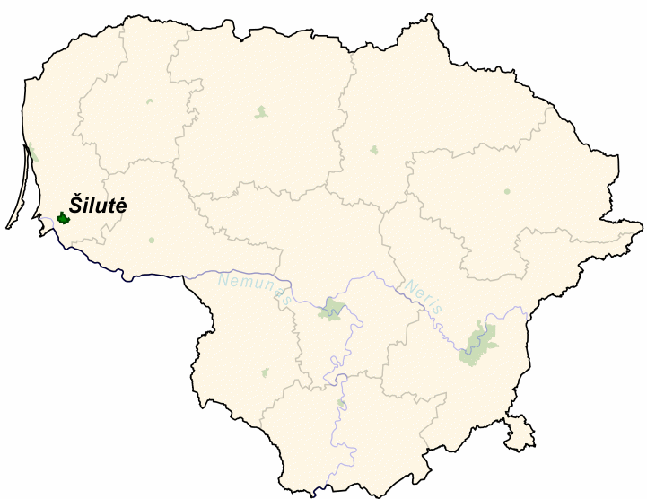

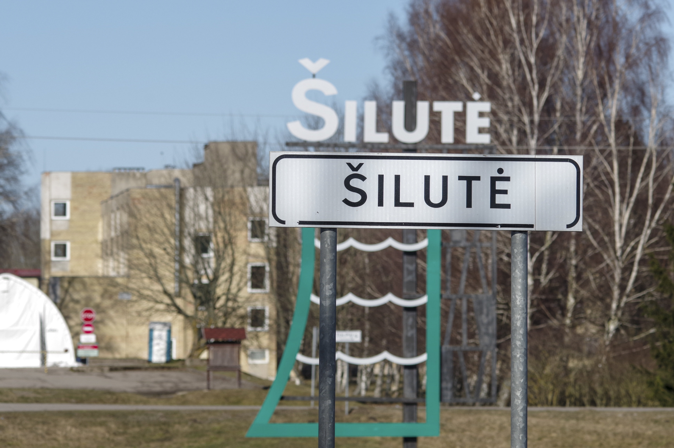

https://www.raudonkepuraite.lt/

Slide 4
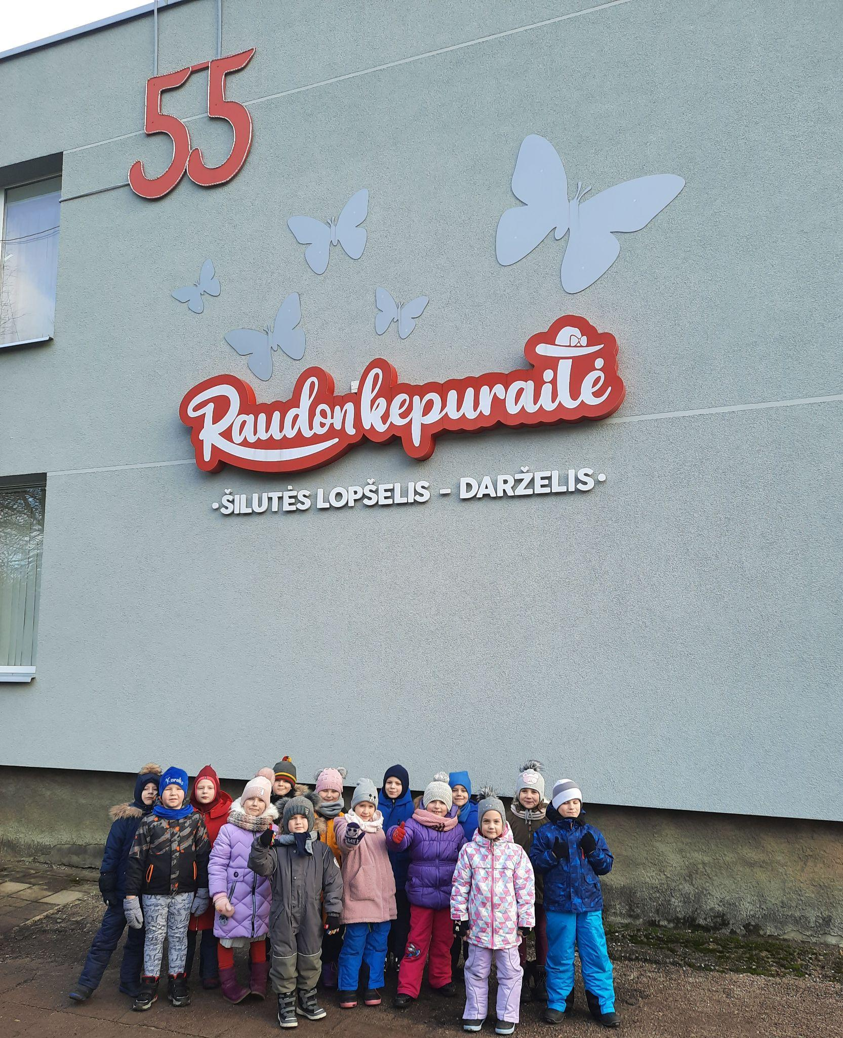
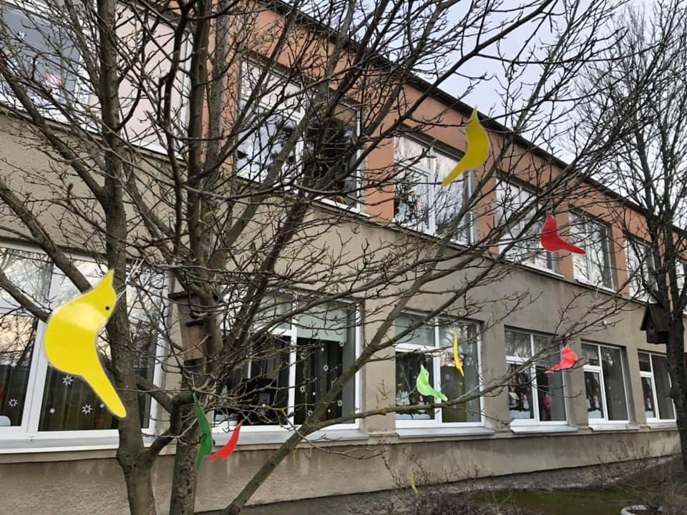
KINDERGARTEN WAS OPENED IN 1966.

Slide 5
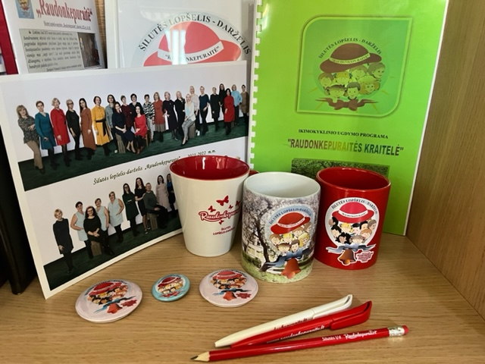
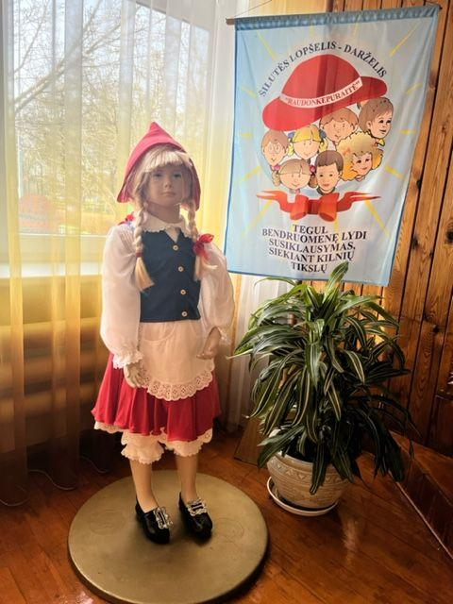
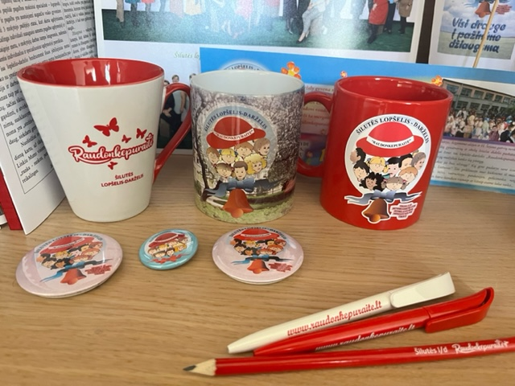
OUR ATTRIBUTES:
Kindergarten has its own anthem!

Slide 6
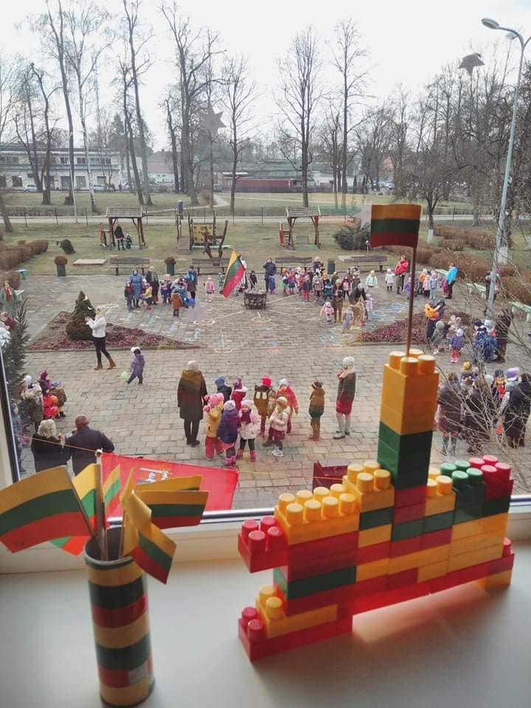
KINDERGARTEN:
4 early preschool groups (1-3 years old);
5 preschool groups (3-5 years old);
3 pre primary groups (5-6 years old);
174 children (15 differently-abled);
22 teachers, 12 teacher helpers, 3 individual assistans and others.

Slide 7
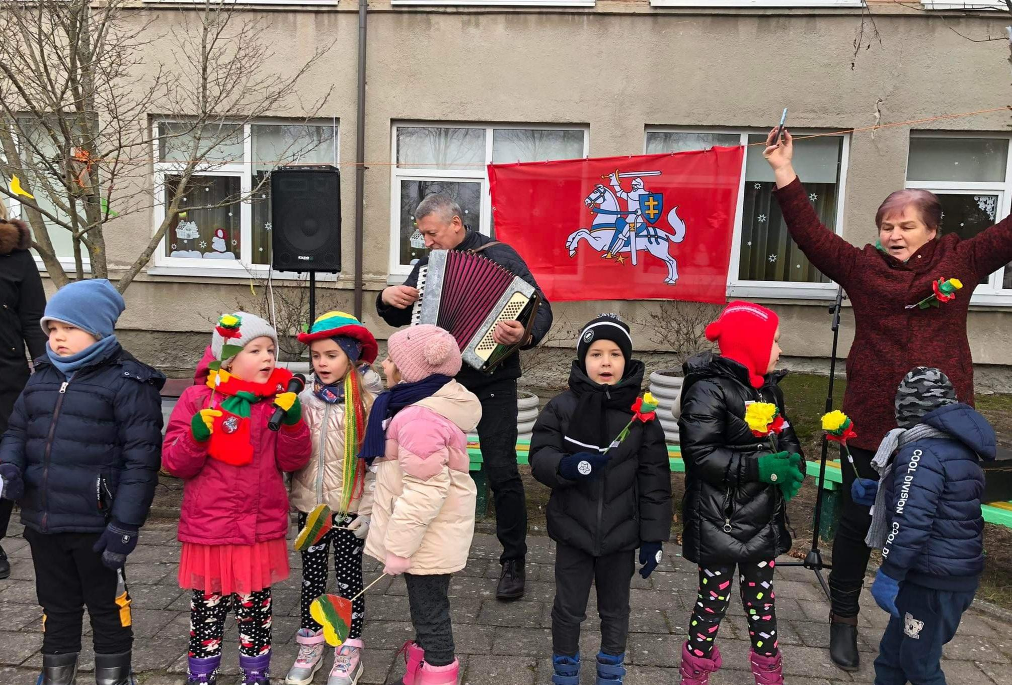
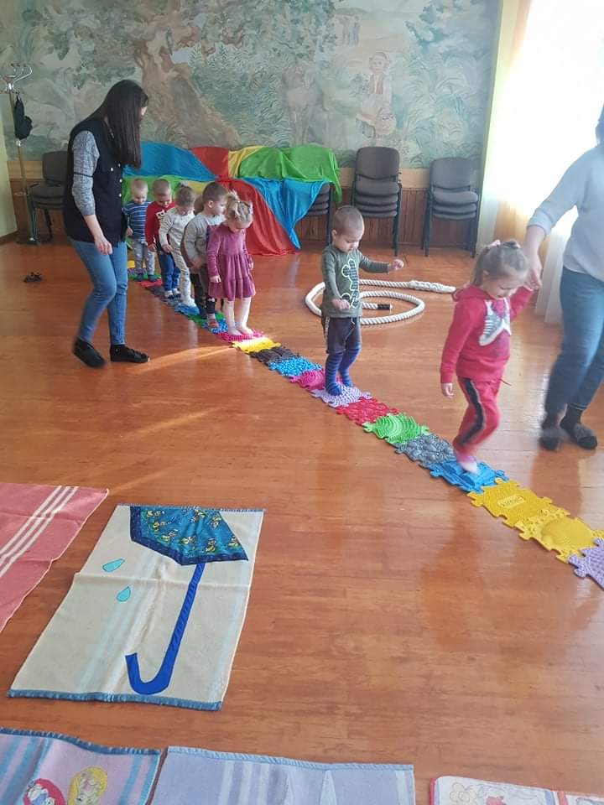
Educational priorities:
safe and healthy lifestyle;
ecological education;
inclusive education for every child;
ethnoculture and citizenship.
OUR MOTTO:
“FREE + HAPPY + HEALTHY CHILDREN”

Slide 8
Educational programs
Kindergarten‘s preschool education program „Raudonkepuraitės kraitelė“ for 1-5 years kids;
Preschool education program for 5-7 years kids (approved by the Ministry of education, Sports and Science);
Internacional childres‘s socializacion program „Zipio draugai“ for 5-6 years kids;
Social-emocional education program „Dramblys“.
All programs develop children‘s competencies (communication, cultural, creativity, cognitive, citizenship, digital, social, emocional, healthy lifestyle) and prepare them for school and are of cours interrelated.

Slide 9
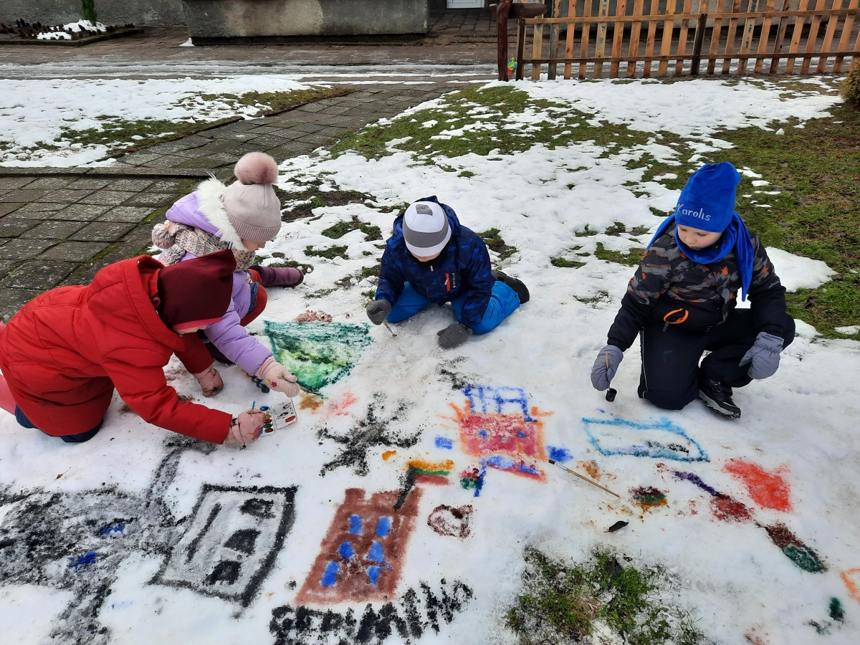
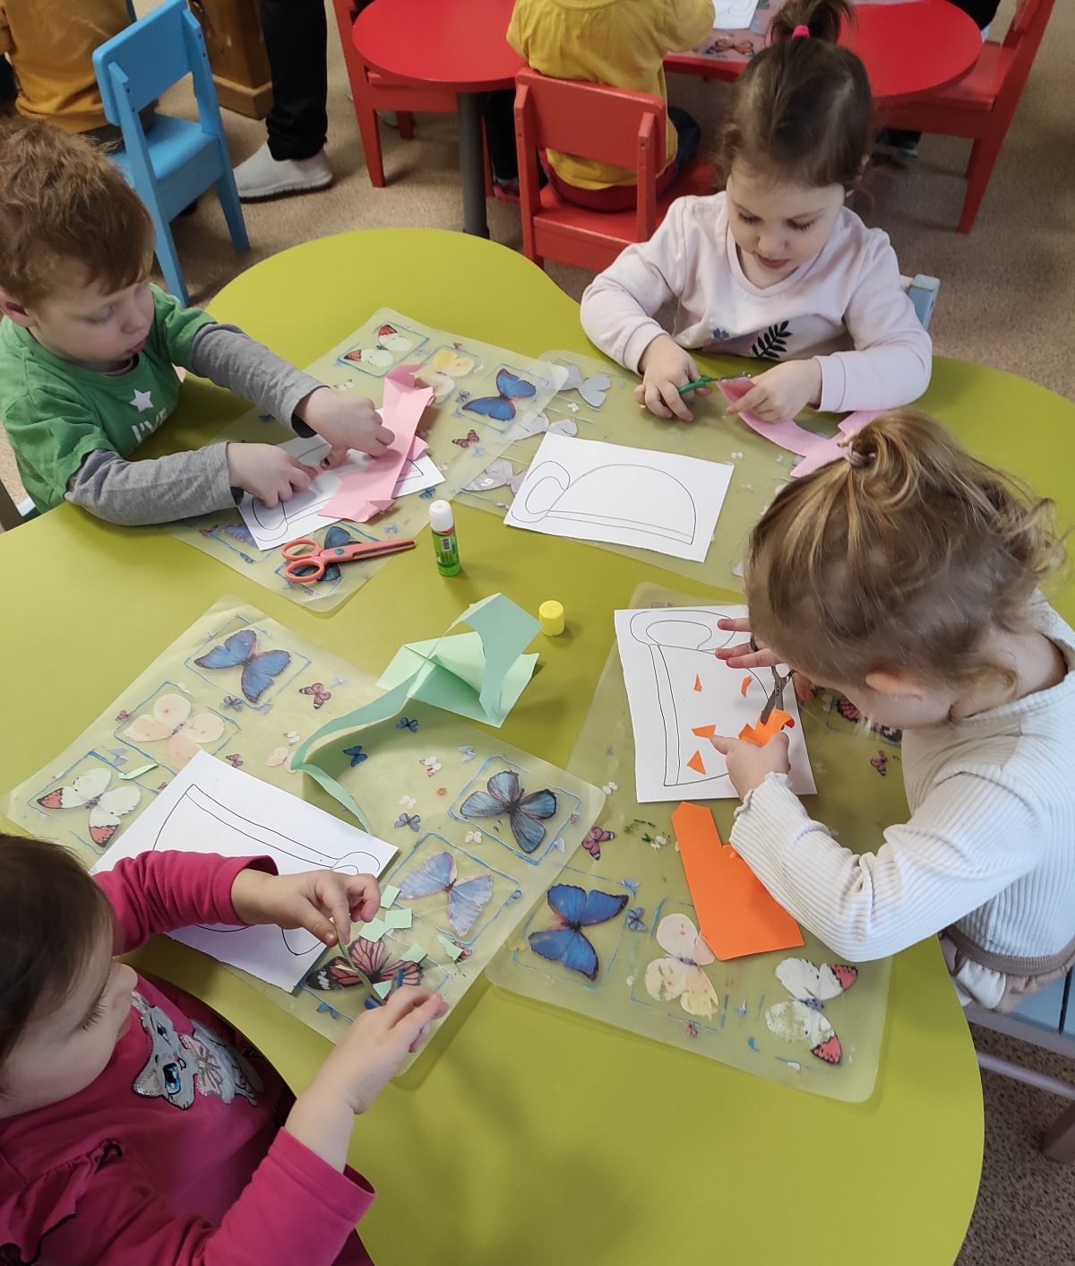
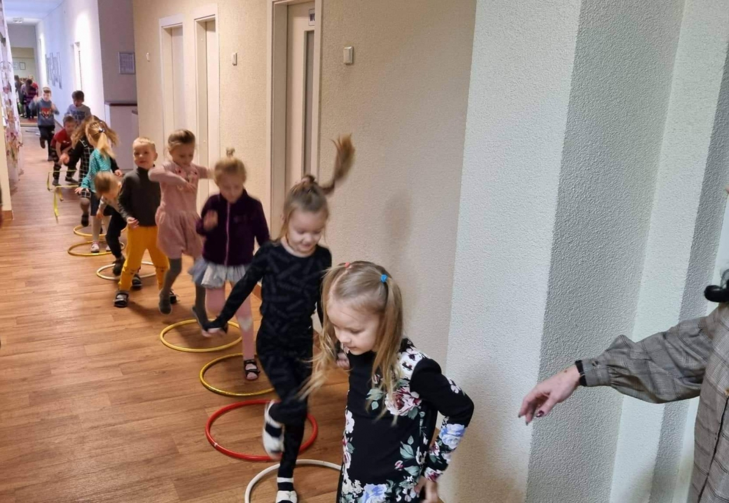
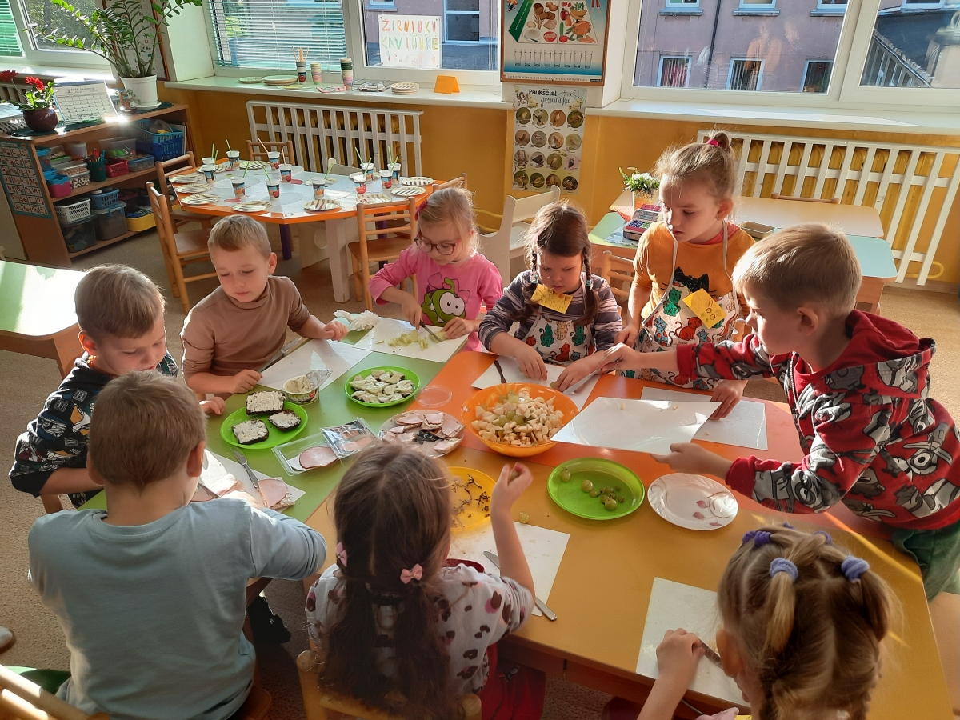
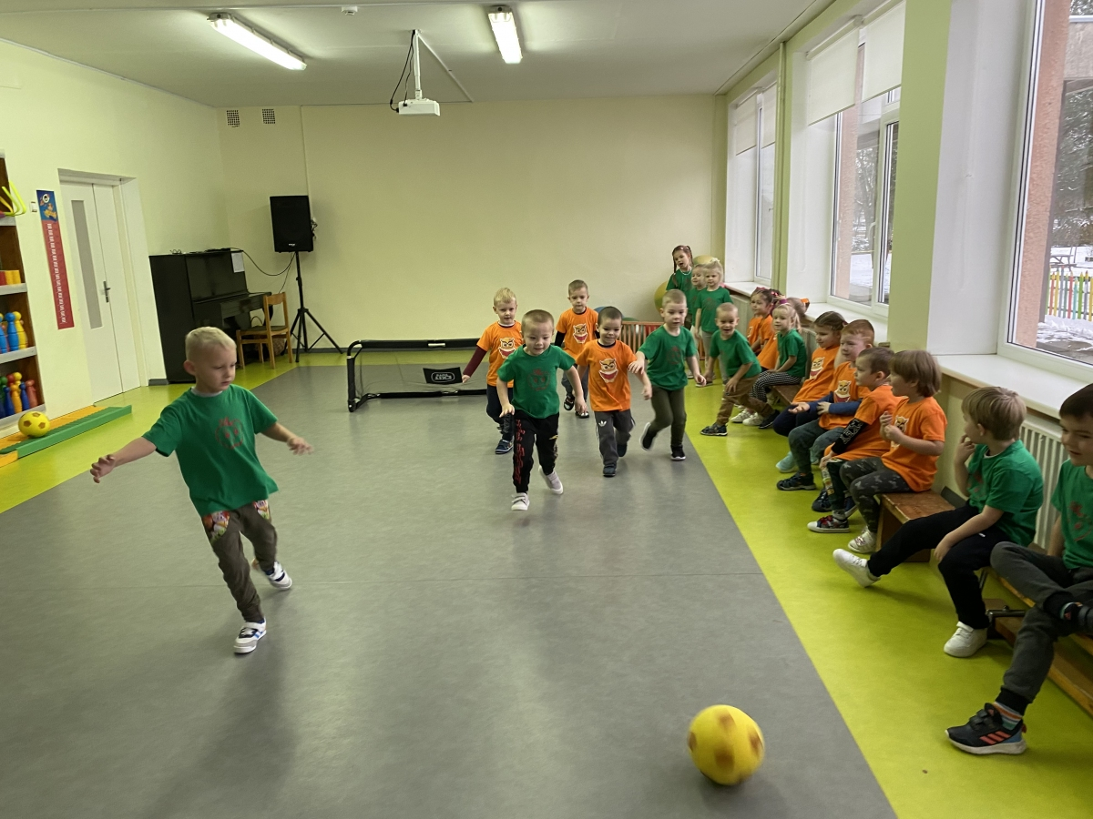
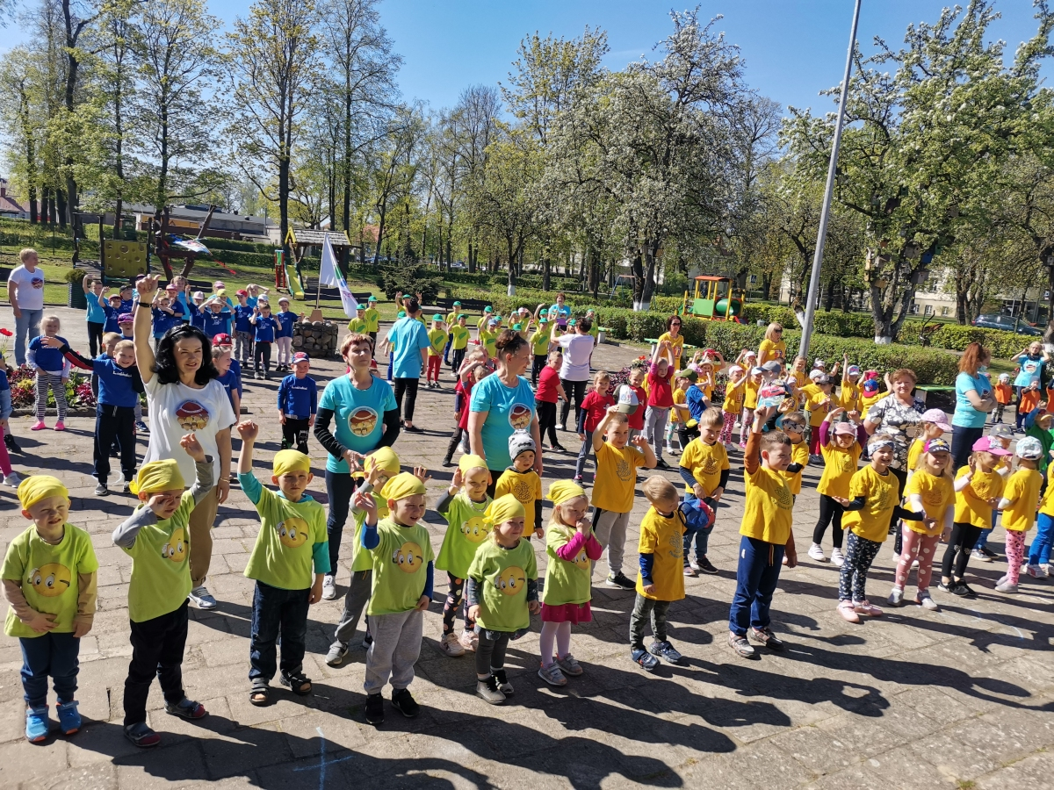
Our day in kindergarten (10 h. 30 min.):
Kindergarten opens at 7 am;
At 8 am – morning exercise;
At 8,12 am – breakfast;
At 9 am – lessons;
At 10 am – snack (fruits, vegetables, nuts);
At 10,40 am – time outside;
From 11,30 am – lunch;
From 12 am till 2,30 pm – rest;
At 3,30 pm – dinner;
From 4 pm – time outside or inside activities;
Kindergarten closed at 5,30 pm

Slide 10
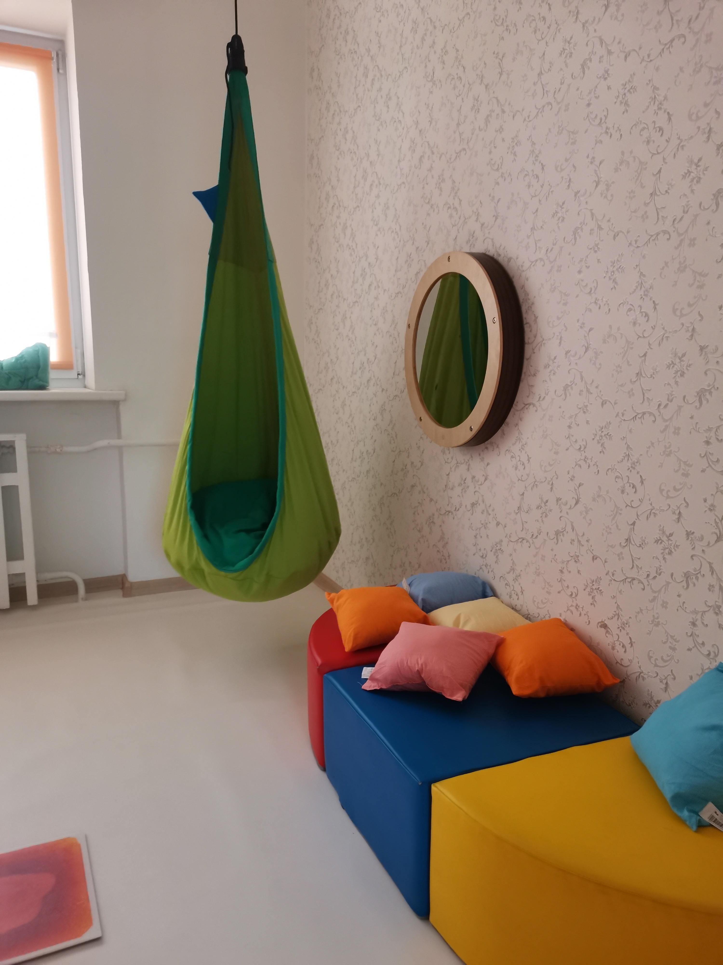
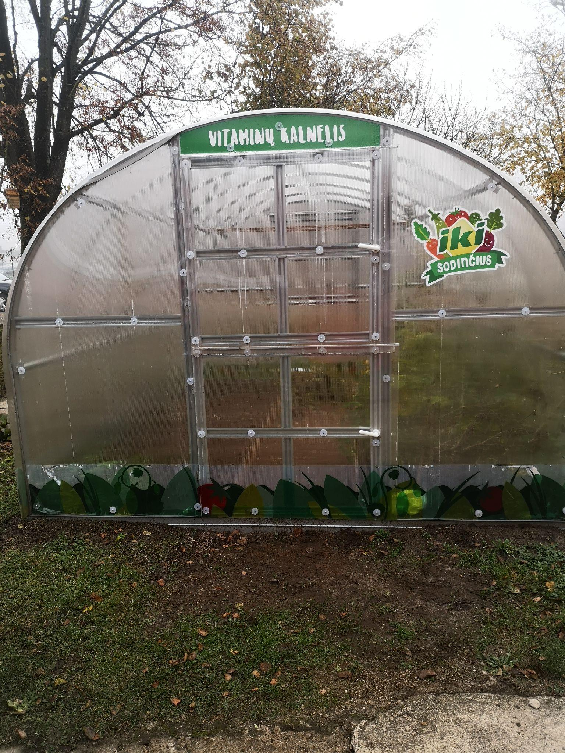
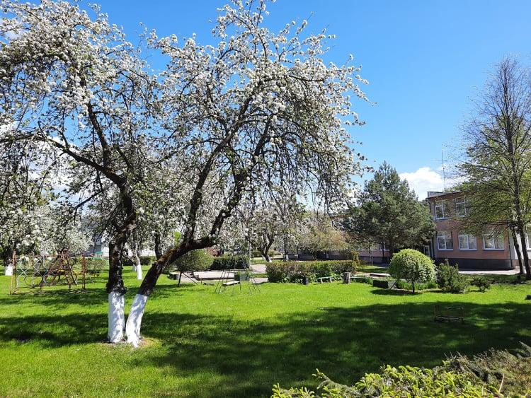
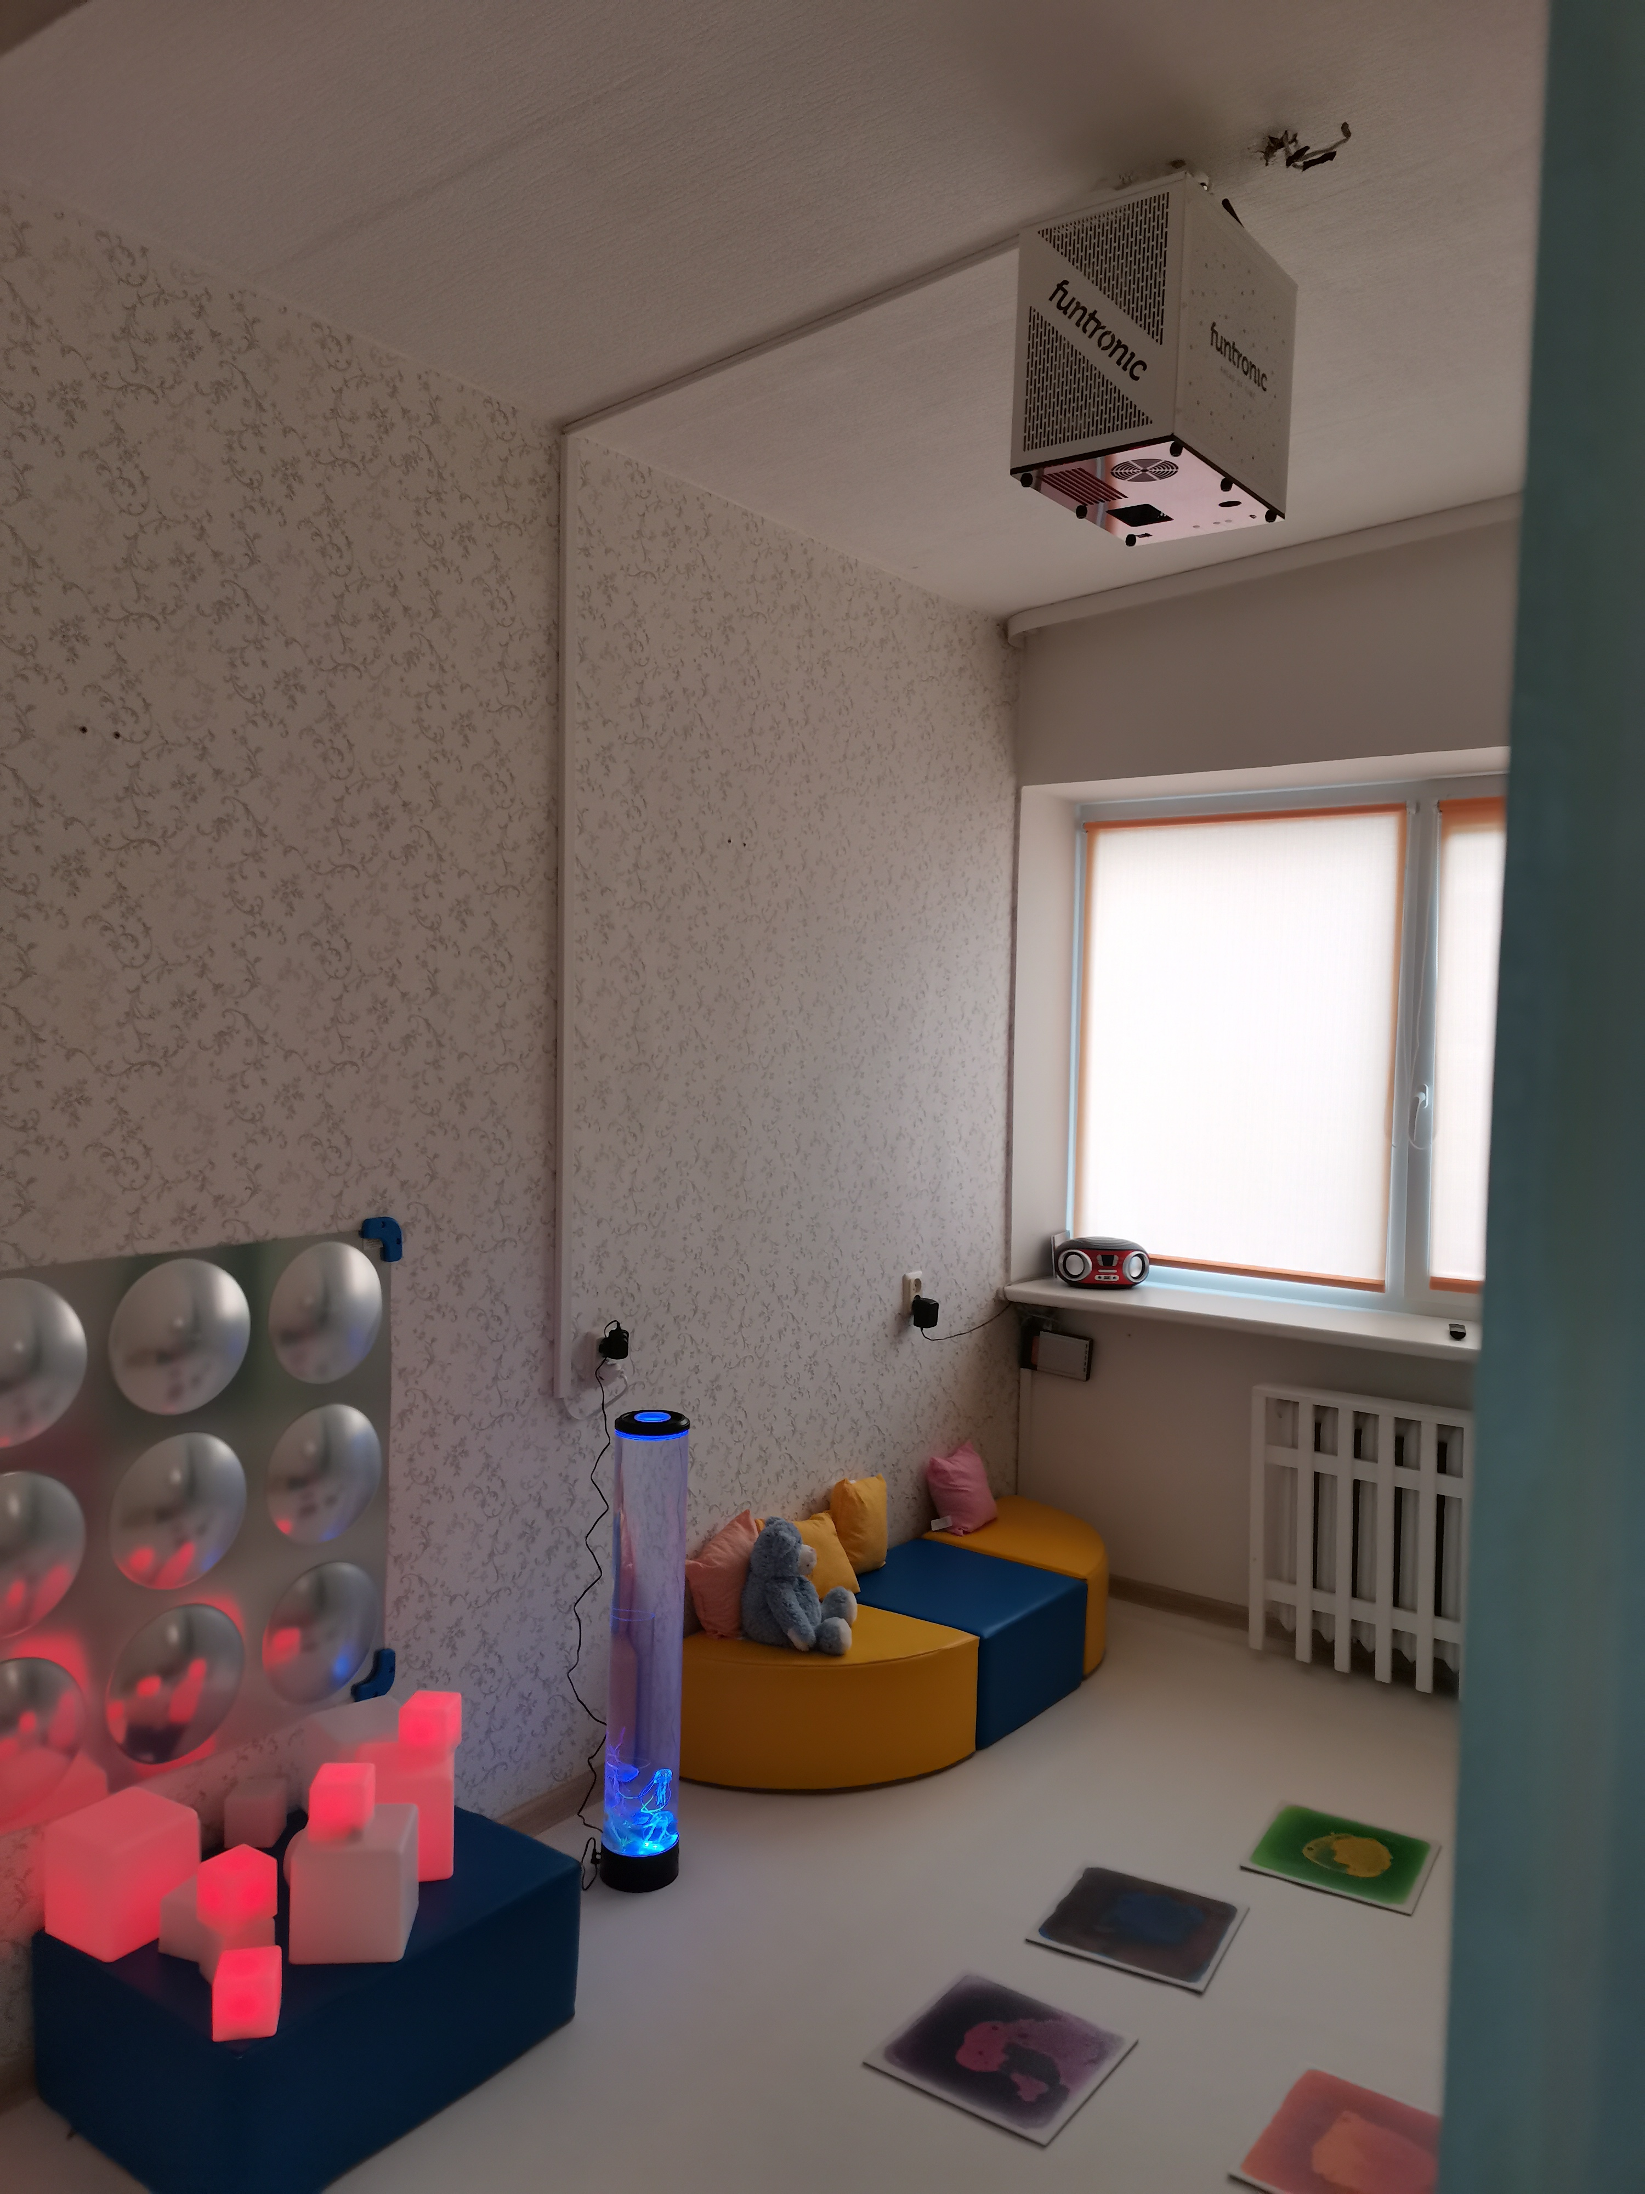
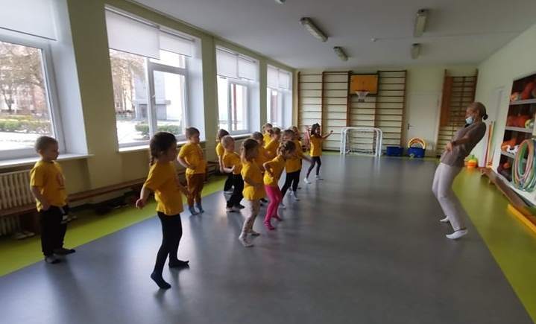
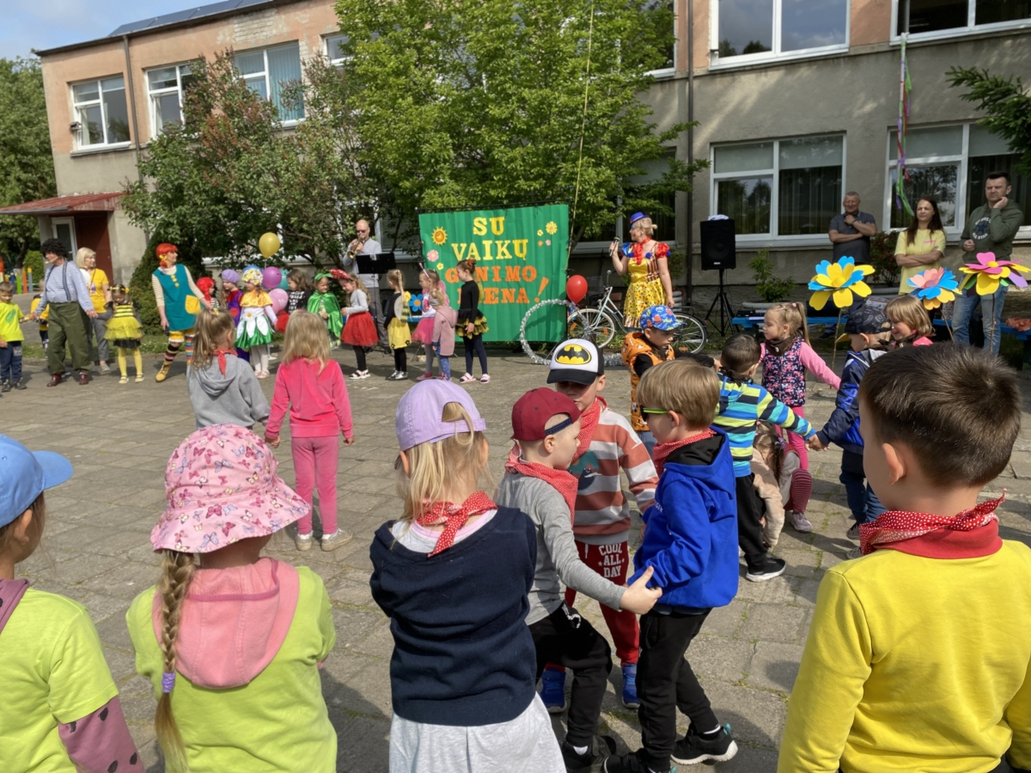
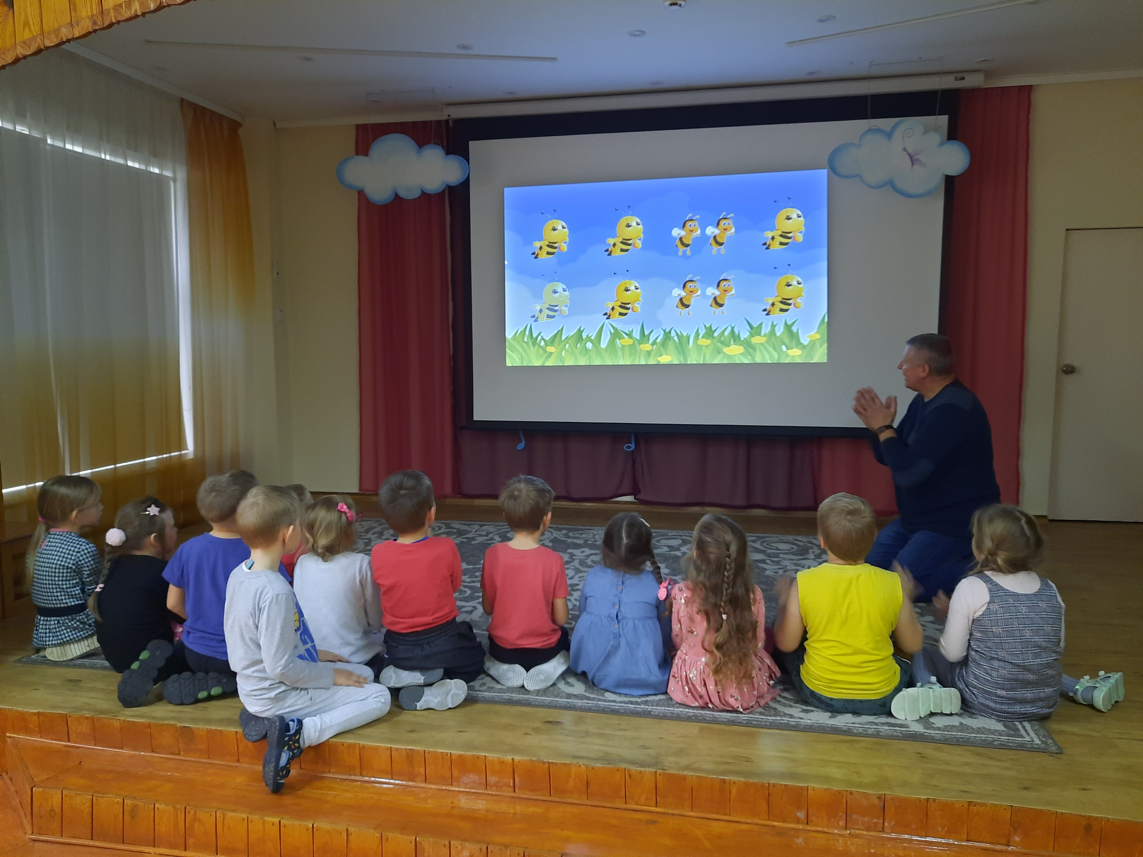
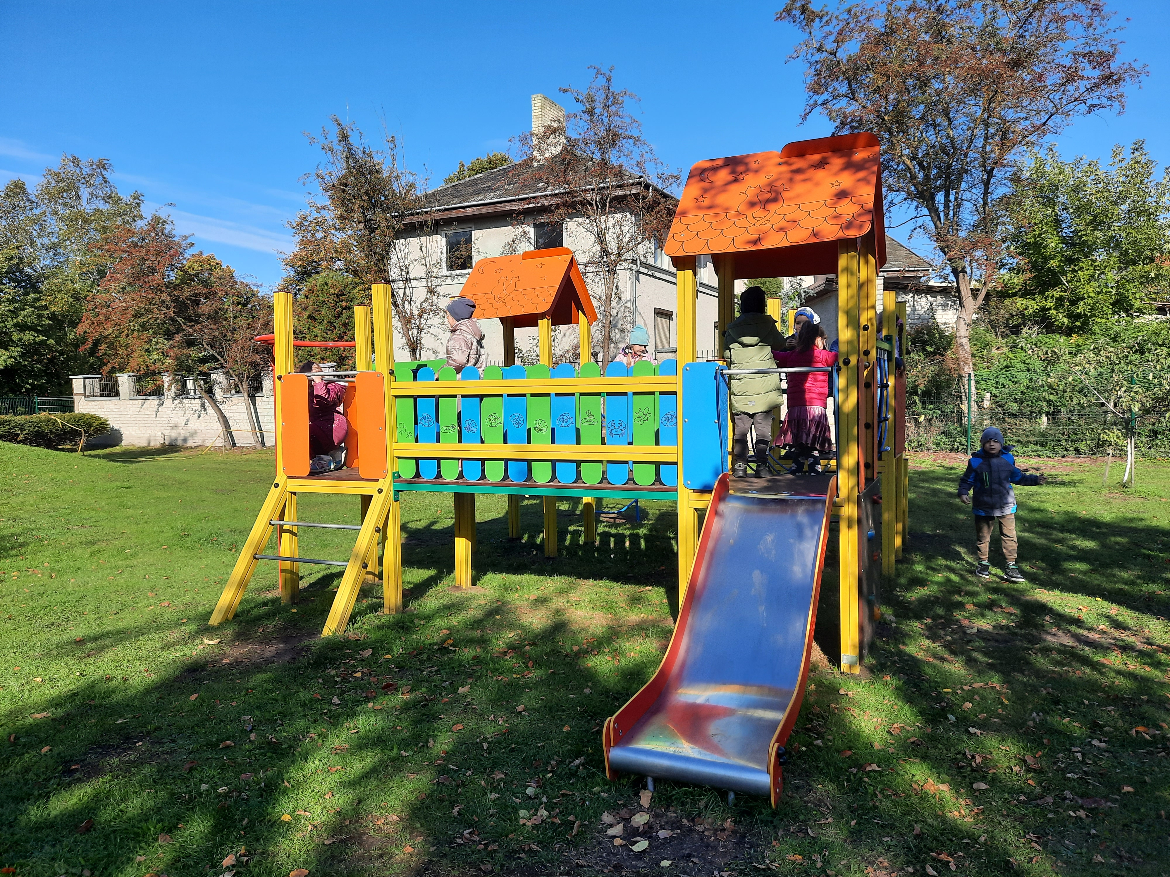
Educational spaces:
groups;
music hall;
gym;
methodical cabinet;
greenhouse;
outdoors playgrounds;
tradition yard;
social pedagogue’s office;
speech therapist’s office;
psychologist’s office;
educantional relaxation room;
kitchen;
laundry.

Slide 11
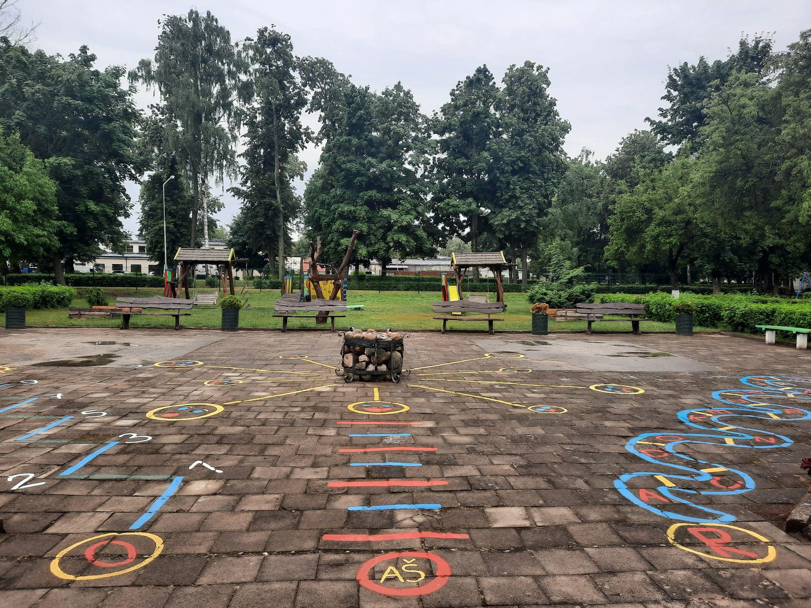
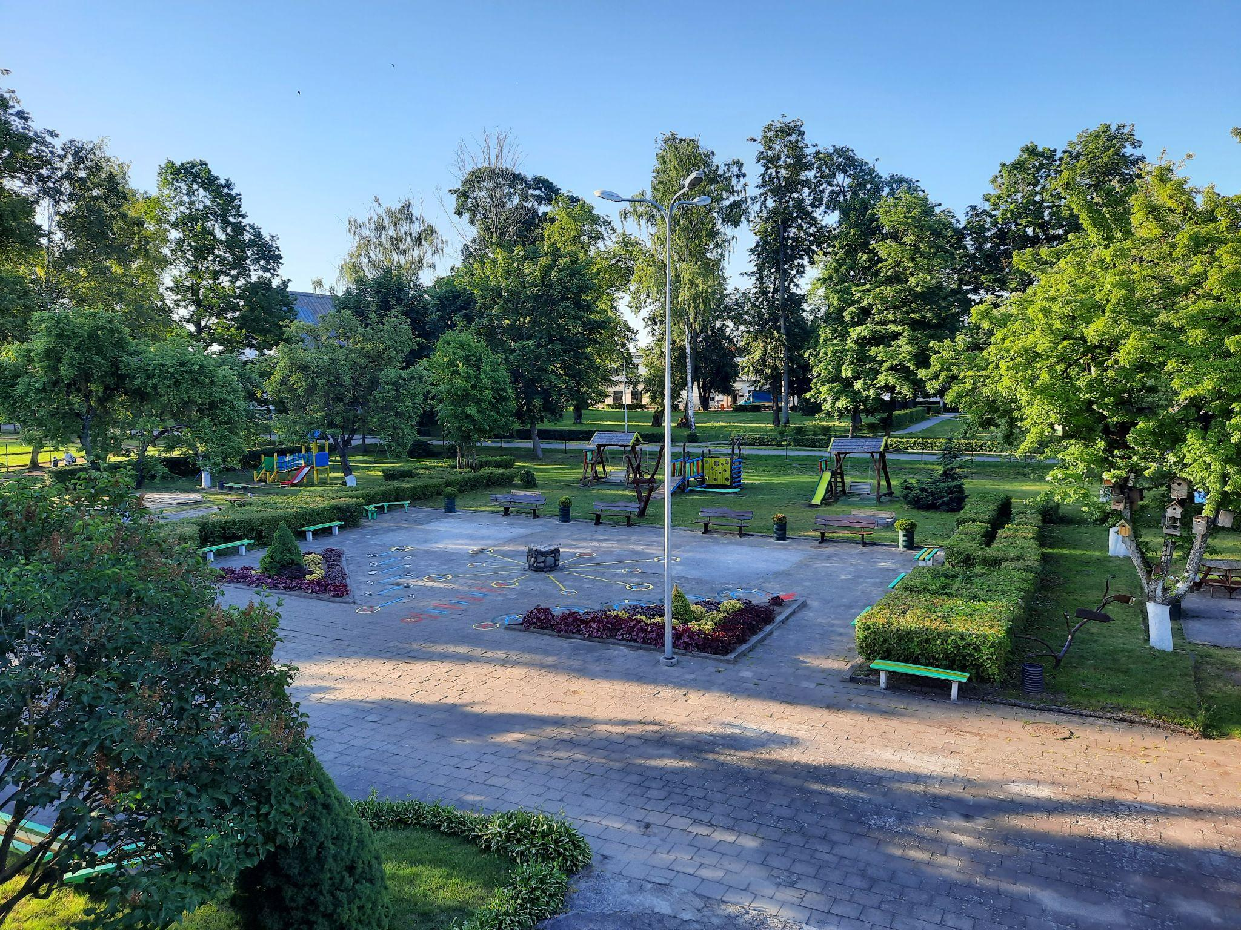
OUR MEETING PLACE FOR
TRADITIONAL FESTIVALS IN KINDERGARTEN:

Slide 12
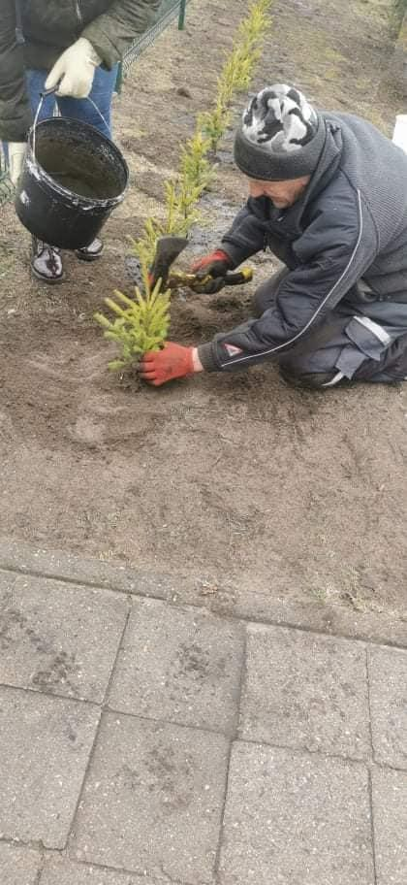
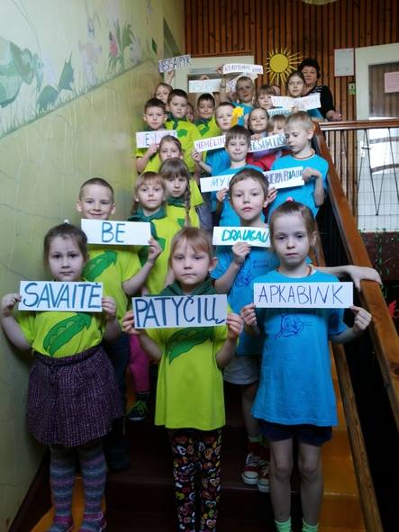
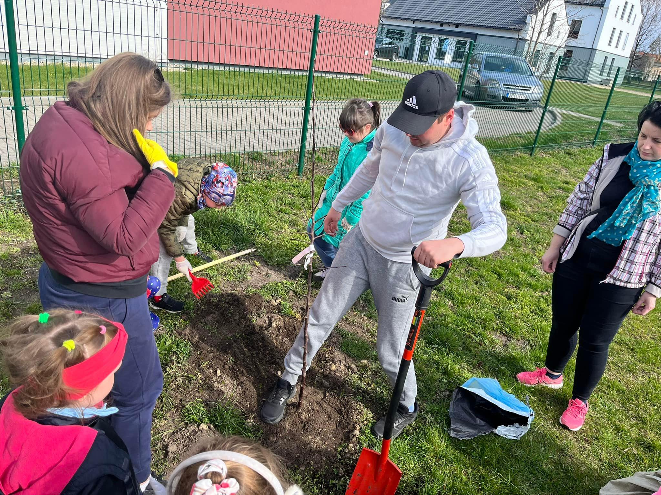
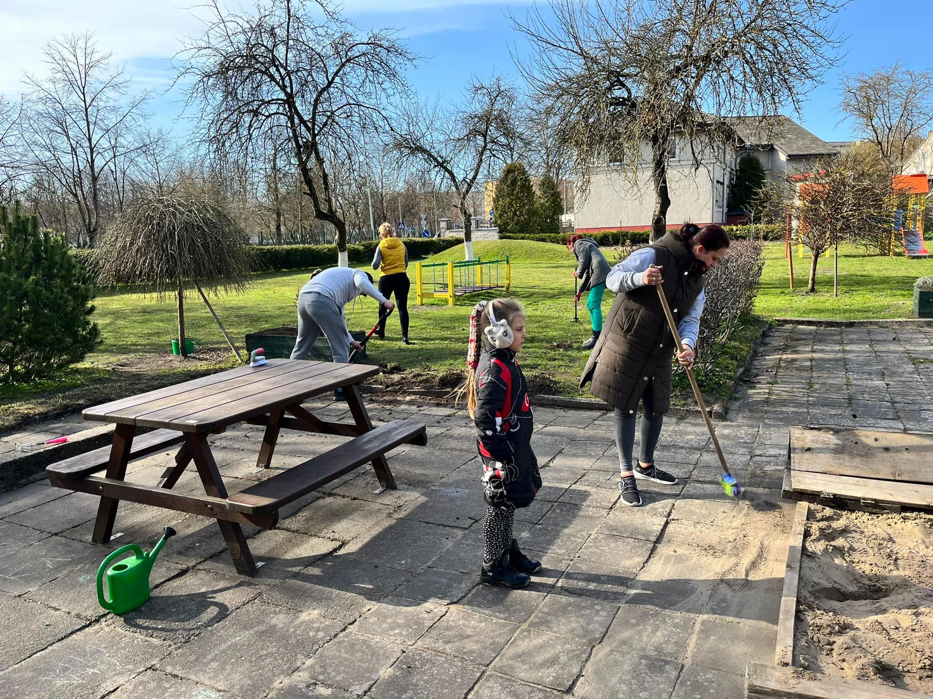
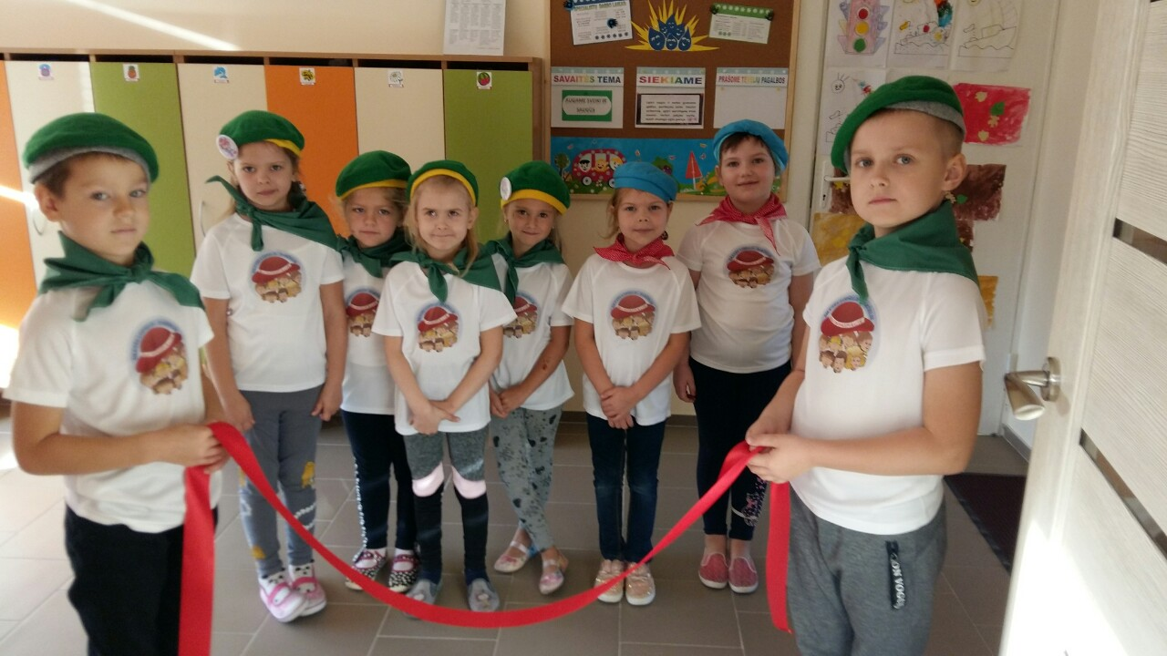
Children’s council and kindergarten’s council:
Counciles mobilize the community for the noble purposes and implementation of tasks, for propose and making decisions.
Children’s council “Tvarkiukas” participates in various republican activities bringing the whole community together.

Slide 13









PROJECTS:

Slide 14
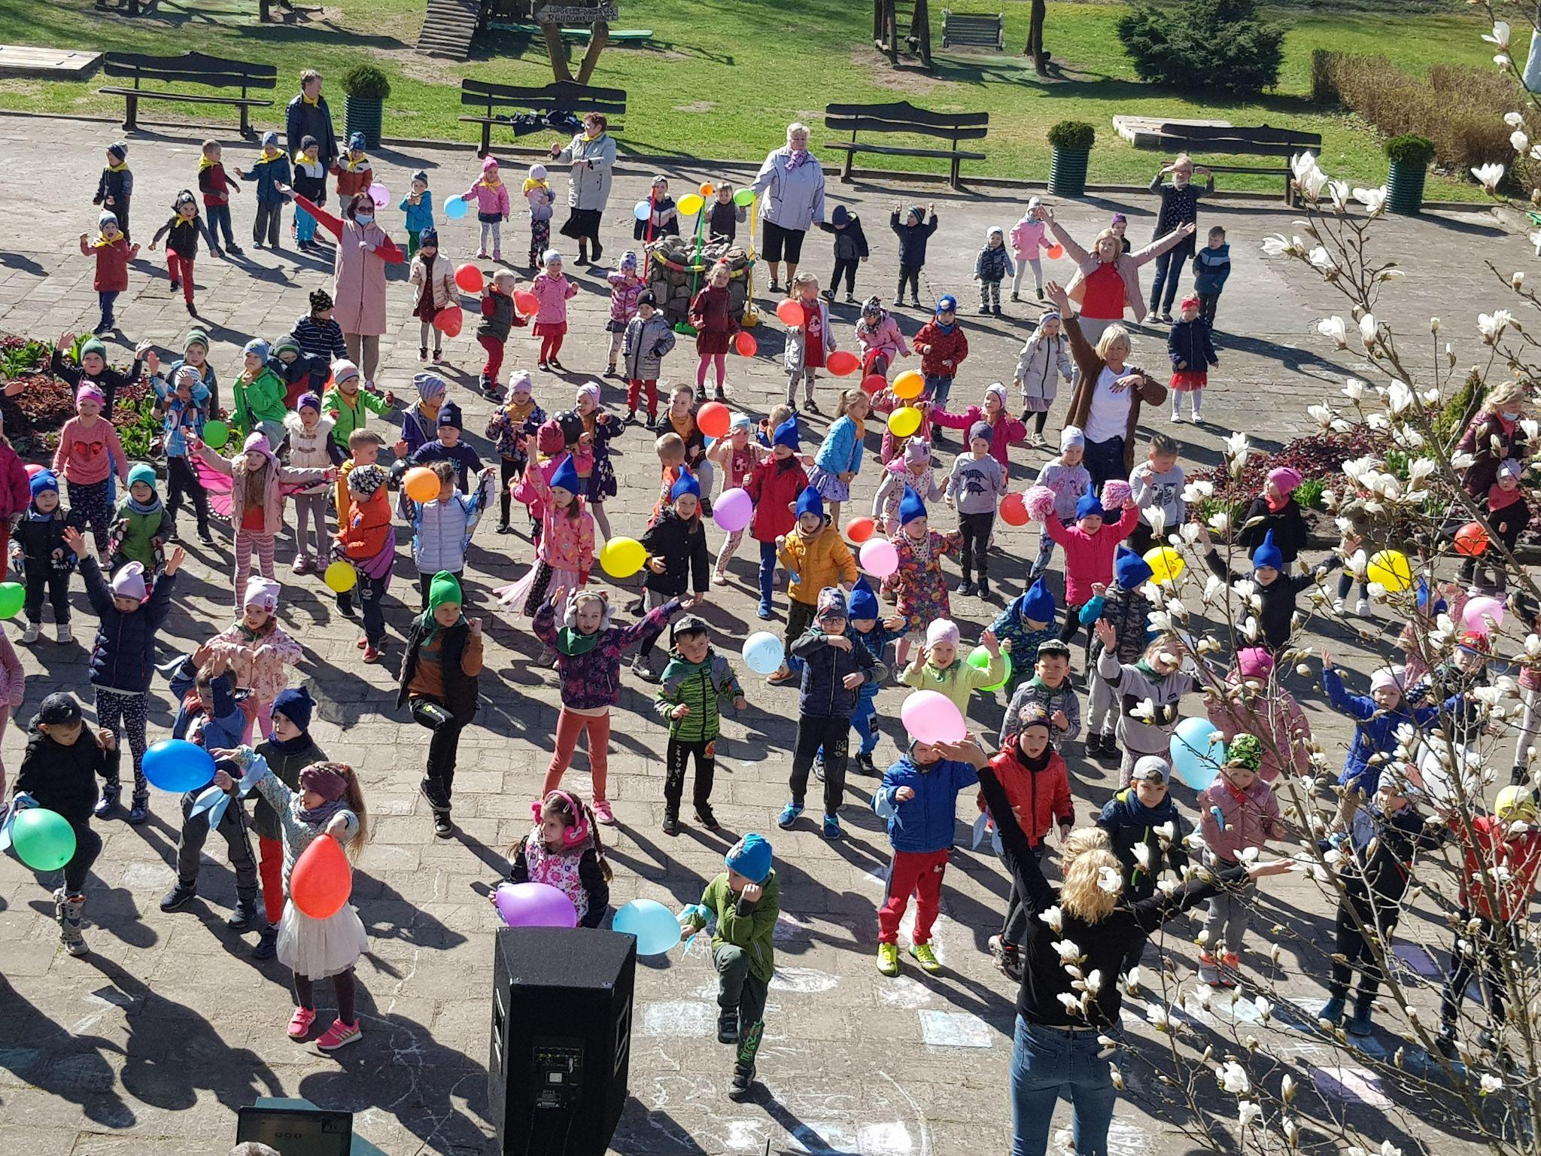
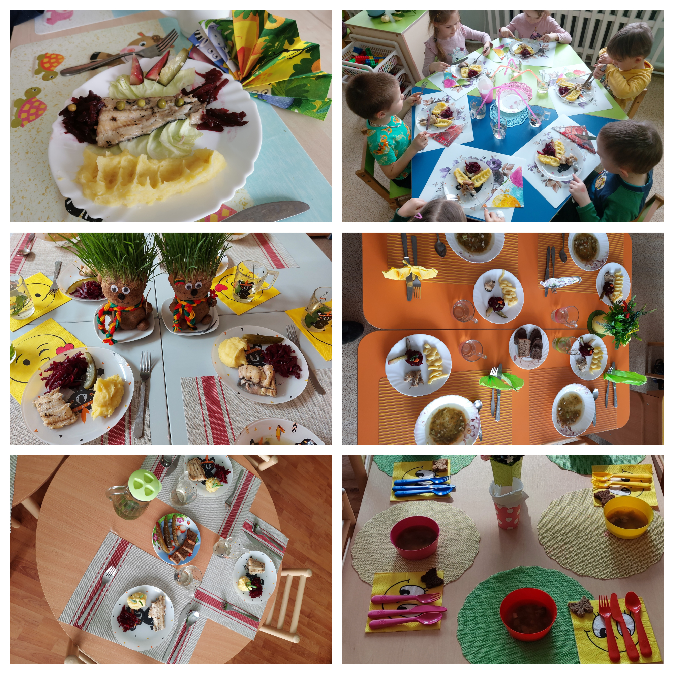
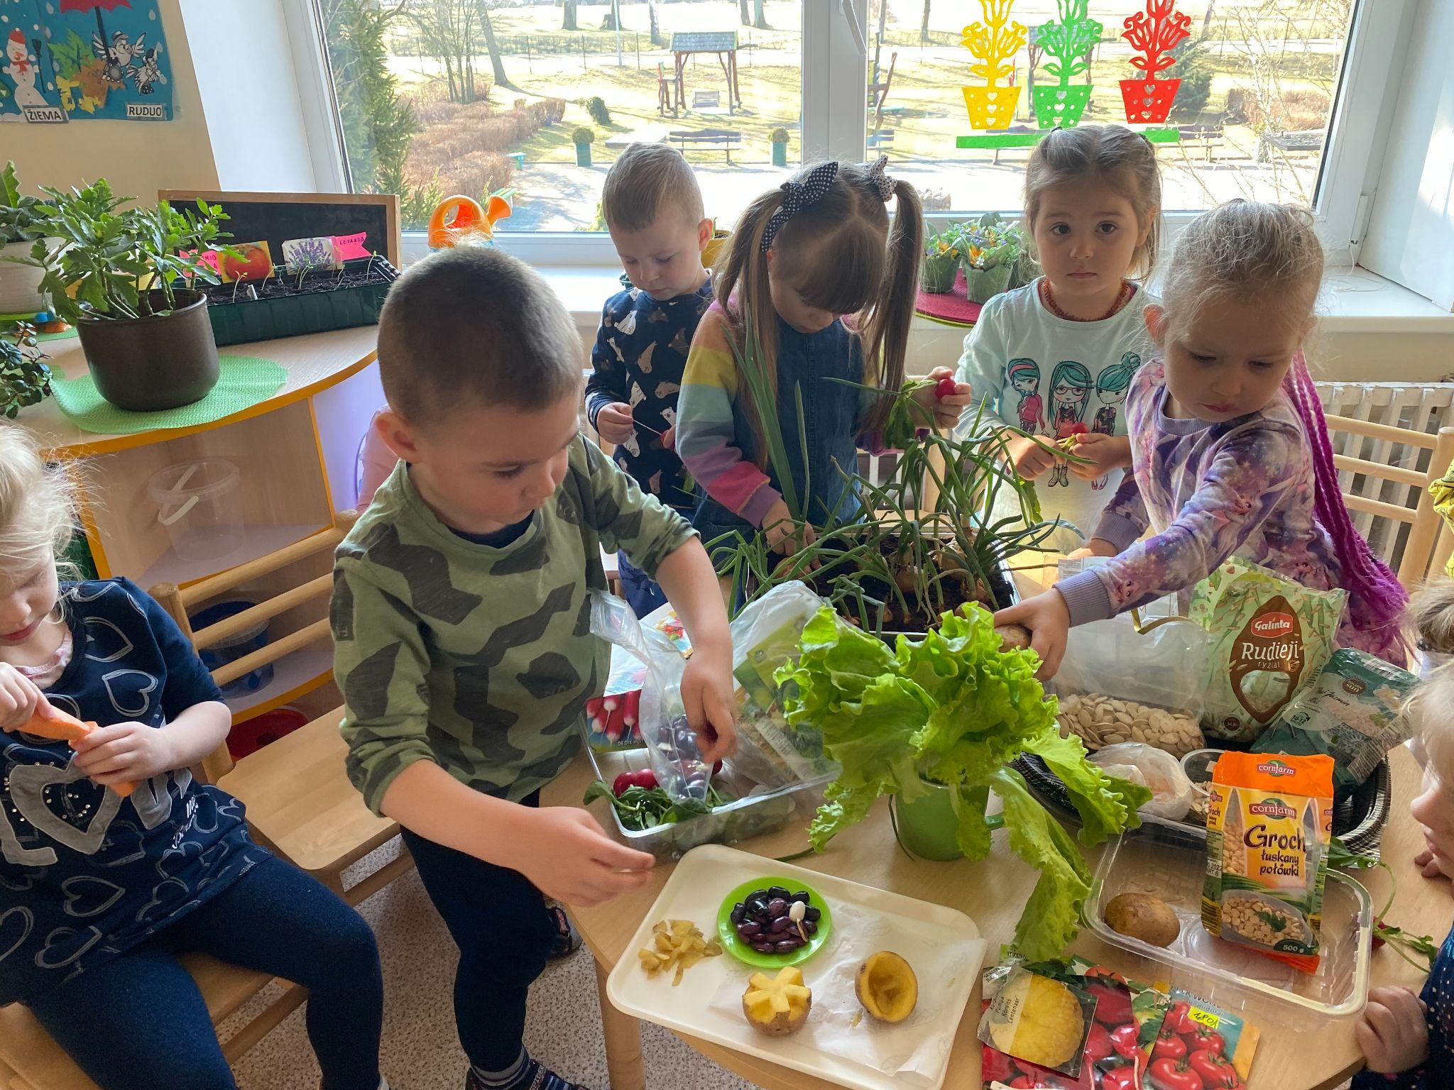
Project “SVEIKATIADA”
We joined the project in 2020. It is a long-term project to develop a healthy children’s lifestyle. During interesting and attractive events children expand their knowledge and understanding about healthy eating, nutrition and physical activity.

Slide 15

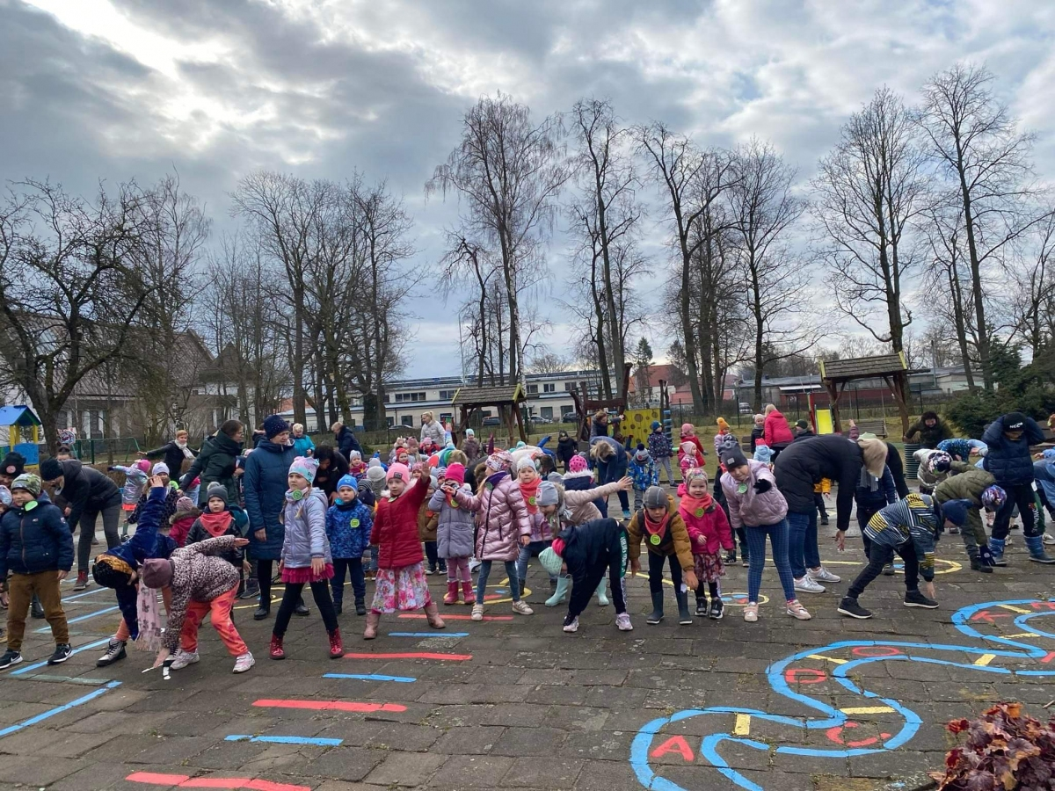
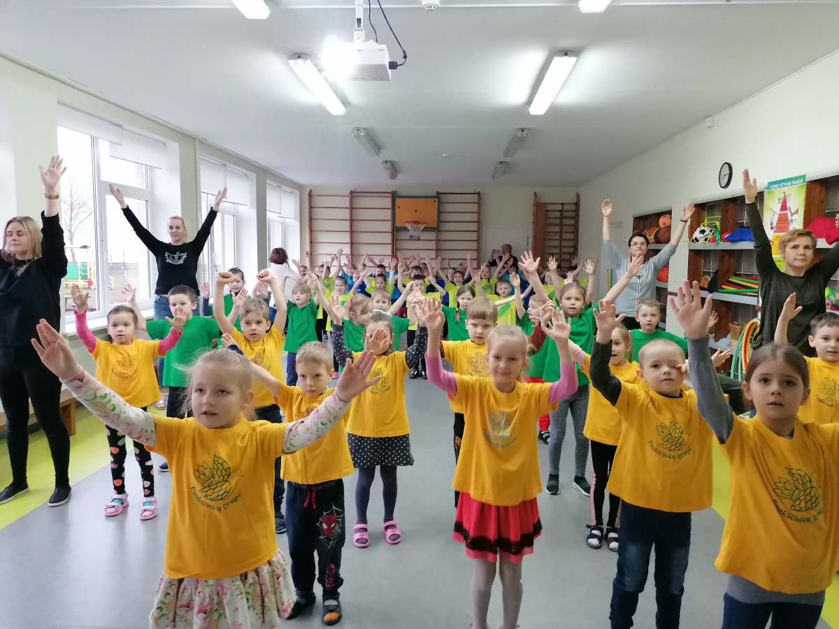
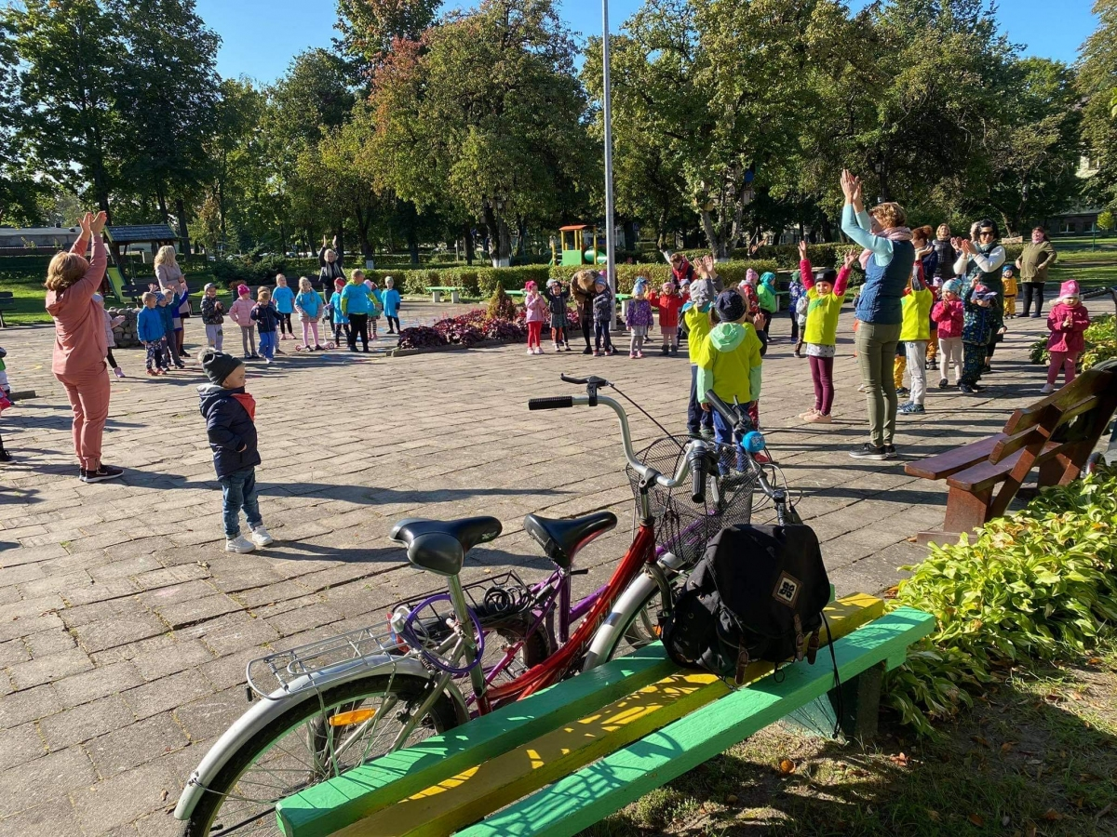
Health living project “SVEIKATOS ŽELMENĖLIAI”
This project started in 2007 in our kindergarten. Children promote and expand the network of healthy kindergartens in Lithuania. It creates a suitable and safe environment for children's health and attractive conditions for children to move and play sports.

Slide 16
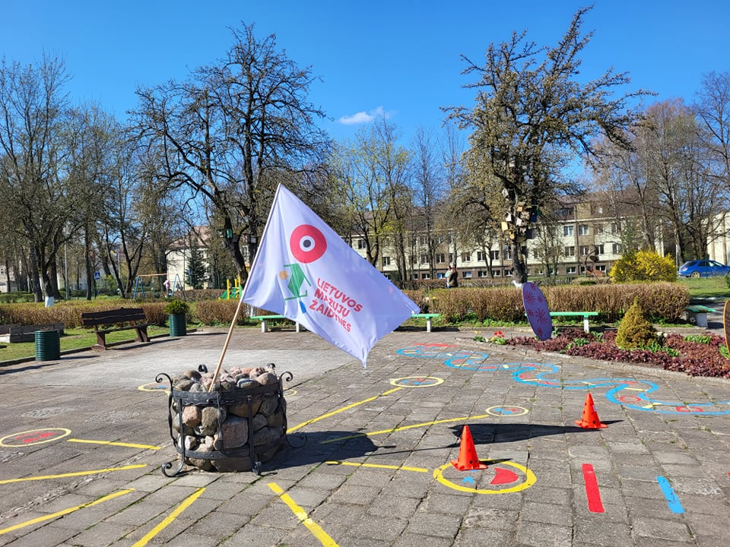
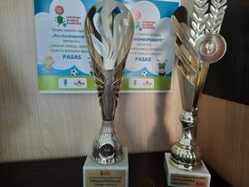
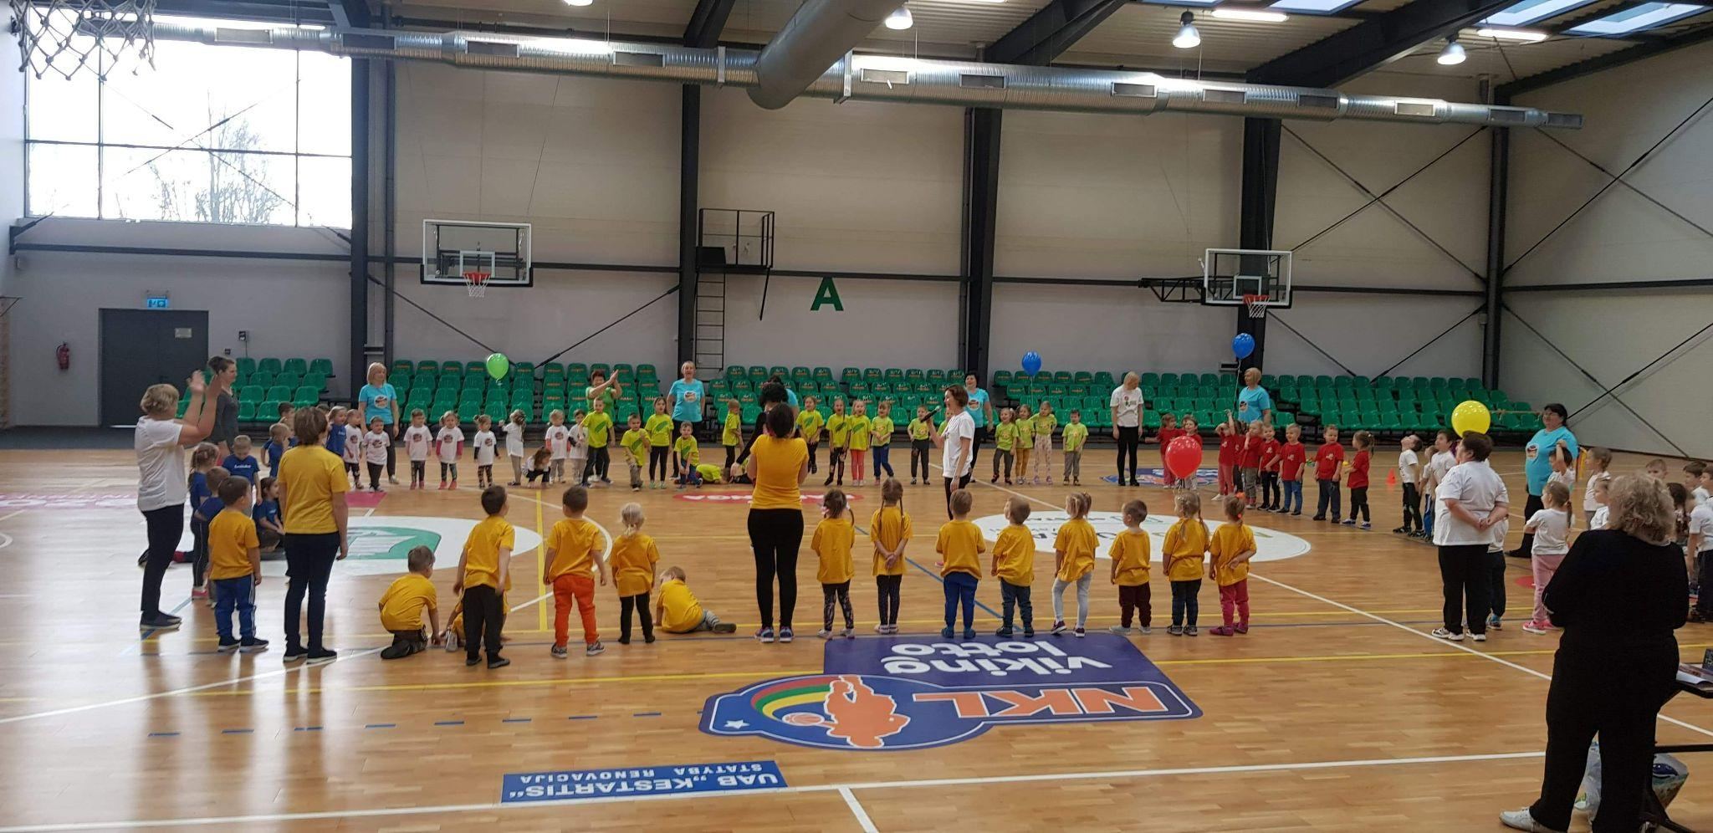
Project “LIETUVOS MAŽŲJŲ ŽAIDYNĖS”
This project started in 2016. The main aim is to increase physical activity in kindergarten and to develop collaboration between kindergartens in Lithuania. Our kindergarten participates since 2018.
Notes:
of

Slide 17
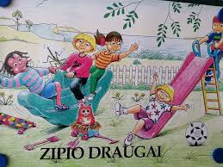
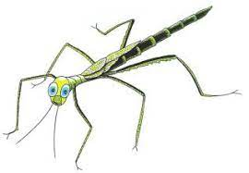
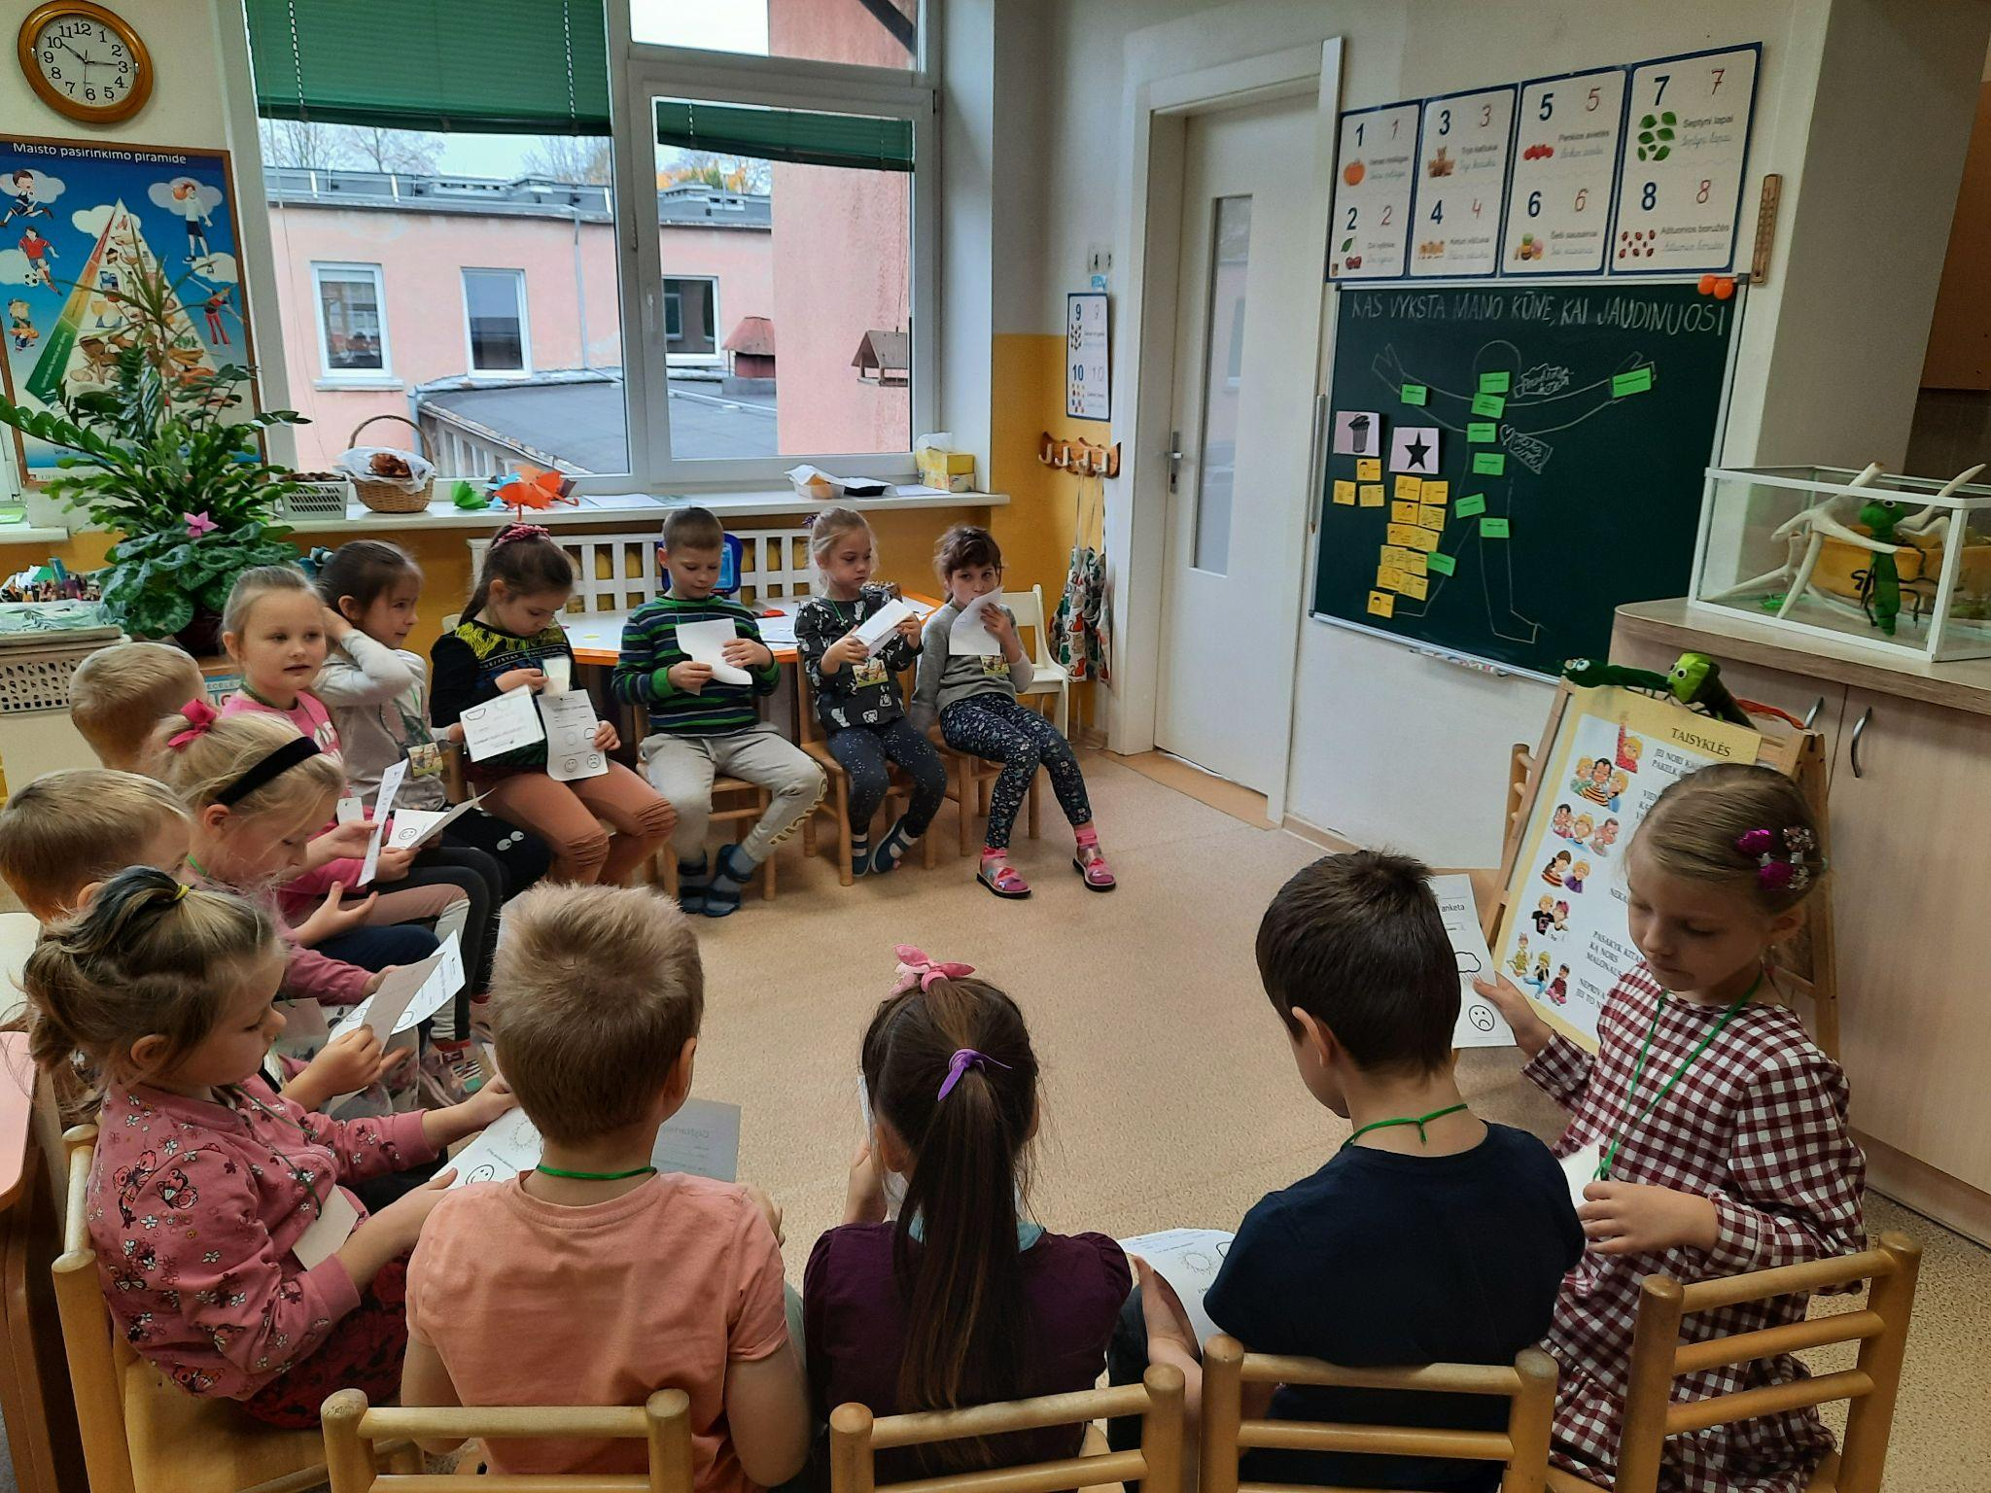
Programme
,,ZIPIO DRAUGAI”
It’s international programme for 5 - 7 years old kids. In Lithuania this programme appeared in 2000. It develops children's social and coping skills, presents the concept of coping with challenges, strategies for overcoming difficulties. Children discuss different themes how to find and keep friends, ask for help, cope with loneliness, bullying or death.

Slide 18
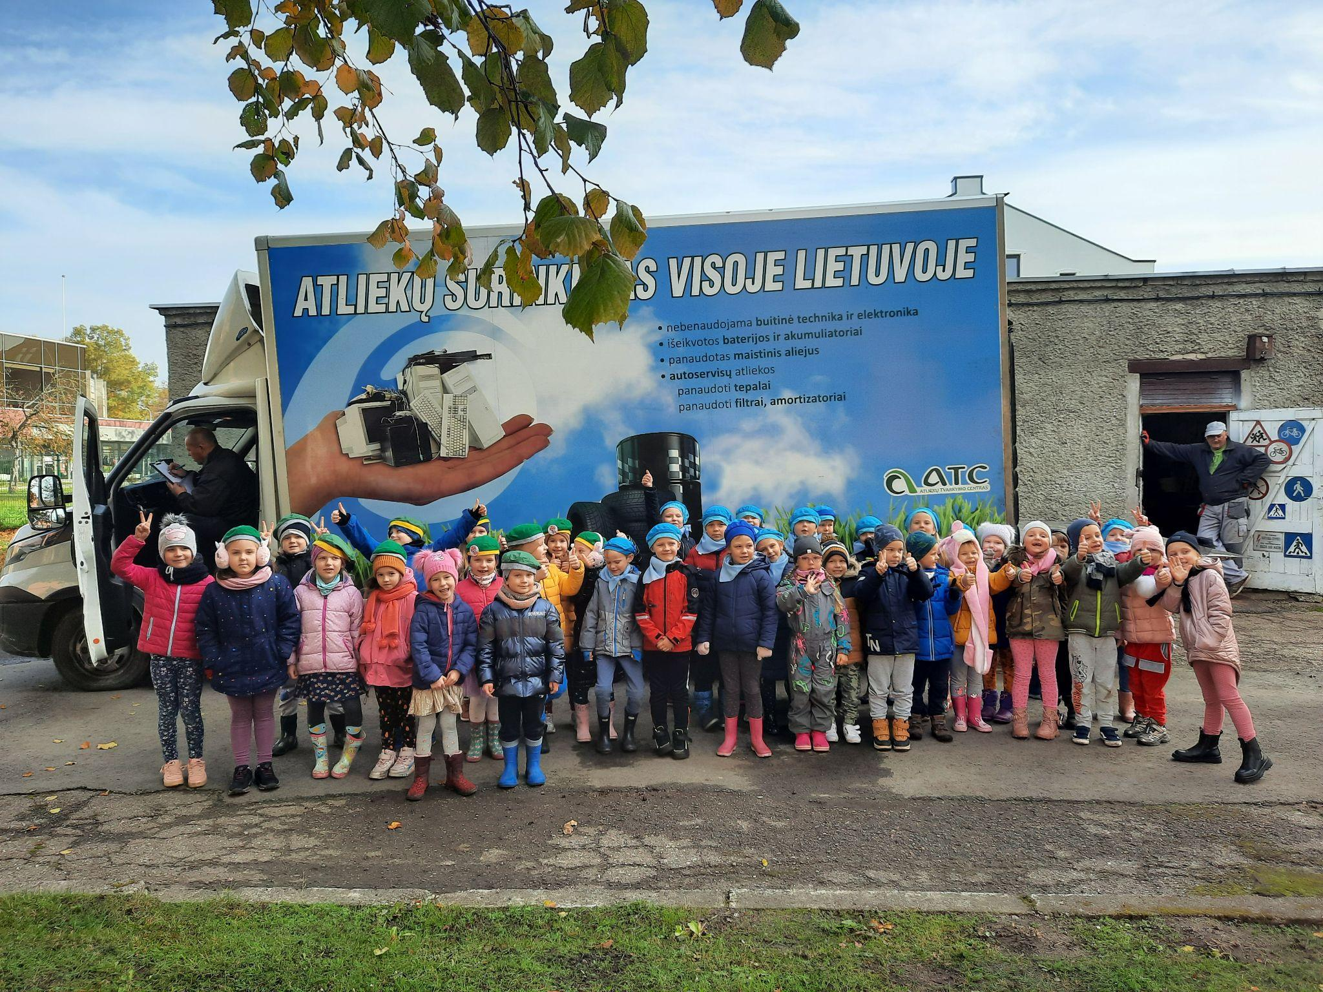
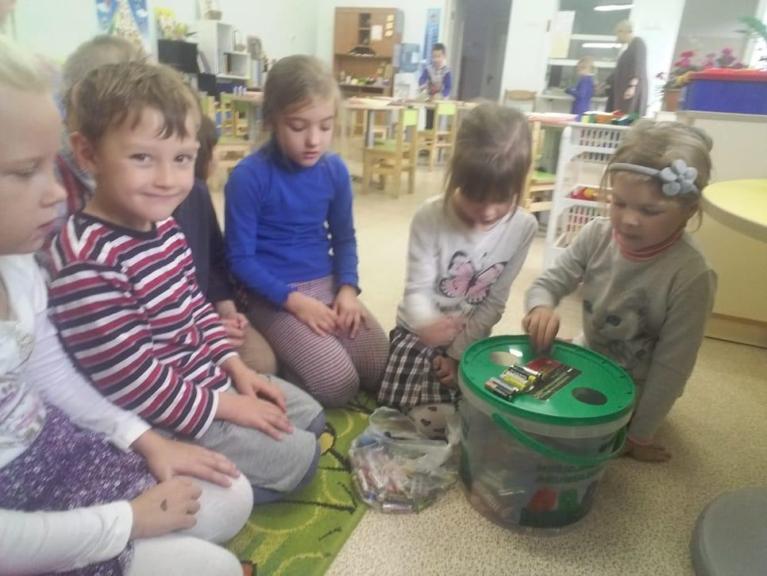
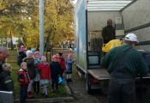
Environmental project “MES RŪŠIUOJAM”
During this project all kindergarten’s community collects electronics, batteries and other waste. UAB “Atliekų tvarkymo centras” takes all these waste for recycling.

Slide 19
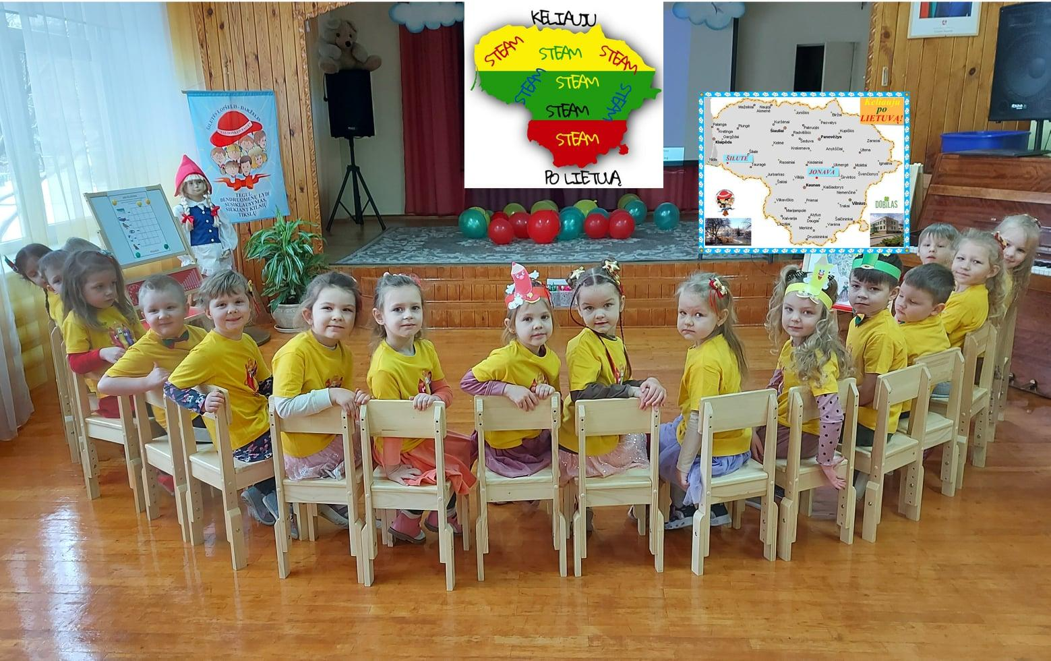


eTwinning projects
Our teachers also participate in different projects in Lithuania and other countries using eTwinning platform. They communicate with other kindergartens, do the same tasks, share photos or even have virtual meetings using Zoom platform.

Slide 20






Erasmus+ program
2021-2022 m. „Creating innovative enviroments in kindergarden „Raudonkepuraite“ (job shadowing to Italy and Palermo);
2023 m. „It our home“ (remote project with Netherlands and Romania)‘
2024 m. „Sustainable playground“ (we become the receiving organization to Slovenia for job shadowing).

Slide 21



„Healthy school“
„Healthy school“ we became in 2022-12-07. We have accredited health promootion program „Augu sveikas 2022-2027“. During this program we have health promotion activities for wholw community.

Slide 22

We’re happy to have you
We wish you to have a good and interesting time!

